Slide 1
TechCon 2020 A08: Running App Connect Enterprise in the Cloud Pak for Integration (CP4I) Andy Garratt Offering Manager, IBM Cloud Pak for Integration andyg@uk.ibm.com

Slide 2
1,459
Notes:
Anyone want to guess what 1,459 is?

Slide 3
Number of People Currently Wondering… “Didn’t I see the photo on the right at Think! ?”
1,459
Notes:
For conferences like these, we get ”Template Decks” so that our presentations look similar – why is that?

Slide 4
Or thinking ‘Isn’t PI equal to…??
3.14159
Notes:
For conferences like these, we get ”Template Decks” so that our presentations look similar – why is that?

Slide 5

And it goes without saying:
“We want all our existing IIB integrations to be migrated ASAP”
Notes:
Does this look familiar? Not only is it from Think, but a lot of the questions from Think are still the same ..

Slide 6
And it goes without saying:
“We want all our existing IIB integrations to be migrated ASAP”
Notes:
Well, yes it does – if I saw you in the Marriott in 2019, “Hello Again!”

Slide 7
A06: Practical Considerations for moving to a more Agile Integration Architecture
Using App Connect with Containers
Andy Garratt, IBM UK
andyg@uk.ibm.com
Notes:
Did you come to Dallas last year (or see one of the webcast repeats)

Slide 8
Integration Technical Conference 2020
A06: Practical Considerations for moving to a more Agile Integration Architecture
Using App Connect with Containers
Andy Garratt, IBM UK
andyg@uk.ibm.com
Notes:
Let’s just update the date

Slide 9
Integration Technical Conference 2020
A08: Practical Considerations for moving to a more Agile Integration Architecture
Using App Connect with Containers
Andy Garratt, IBM UK
andyg@uk.ibm.com
Notes:
And the session number

Slide 10
Integration Technical Conference 2020
A08: Practical Considerations for moving to a more Agile Integration Architecture
Using App Connect with Cloud Pak for Integration
Andy Garratt, IBM UK
andyg@uk.ibm.com
Notes:
And the titile

Slide 11
Integration Technical Conference 2020
A08: Practical Considerations for moving to a more Agile Integration Architecture
Using App Connect with Cloud Pak for Integration
Andy Garratt, IBM UK
andyg@uk.ibm.com
Notes:
My name’s still the same – although I now have a different job!

Slide 12

Integration Technical Conference 2020
A08: Practical Considerations for moving to a more Agile Integration Architecture
Using App Connect with Cloud Pak for Integration
Andy Garratt, IBM UK
andyg@uk.ibm.com
Notes:
We have a cool new logo!

Slide 13
Integration Technical Conference 2020
A08: Practical Considerations for moving to a more Agile Integration Architecture
Using App Connect with Cloud Pak for Integration
Andy Garratt, IBM UK
andyg@uk.ibm.com
Notes:
But the overall key theme is the same!

Slide 14
Risk Free Deployment
Cloud / Location Independence and portability
Embrace DevOps
Escape the “backlog trap”
“Everything is built using a fully-automated pipeline”
“Each integration has independent pipelines”
“We want to be able to upgrade and/or patch the runtime without months of retro-testing”
”If they want to build integrations with their teams, that’s fine”
”We want to be able to run our integrations wherever makes most sense. We also want to move them around”
”We want to deploy or patch an API or a service independently of all other services”
”What gets built in DEV is what’s deployed to PROD”
“We want to be more responsive to our API consumers and be able to build faster”
“Minimum/Zero dependencies – embrace the container concept”
”Just another container. Deploy integrations as microservices”
”Developer testing is on a multi-instance cluster. No more ‘it works on my laptop’”
”Re-use by copy – look at NPM / git copy+fork approach
“We want to deploy and patch ‘live’ without impacting our users”
Notes:
What defines success for YOUR organization? Any of these? Even one of them can drive business value

Slide 15
Agile Integration Architecture
Modernizing integration
to enable
business agility
Improve build independence and production velocity
(deployment agility)
Architecture & design
Fine grained deployment
People & Process
Decentralized Ownership
Accelerate agility and innovation
(development agility)
Infrastructure & Technology
Dynamic scalability and inherent resilience
(operational agility)
Cloud native
infrastructure
Notes:
How do we defined AIA? There are three key areas to visit.

Slide 16
Go simple and big if possible
Notes:
Here’s another piece of advice from our template

Slide 17
Go simple and big if possible
Notes:
Let’s just fix that up to be relevant here

Slide 18
Cloud Integration Platform Makes it Easier!
https://www.ibm.com/cloud/integration/platform
Notes:
How did we say to make ACE on containers simple/easier before? Use the cloud integration platform

Slide 19
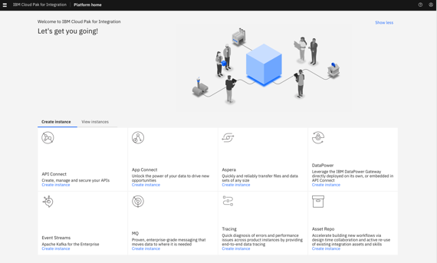
Cloud Pak for Integration Makes it Easier!
https://www.ibm.com/cloud/integration/platform
Notes:
Of course that’s now got a new name

Slide 20
Cloud Pak for Integration Makes it Easier!
Integration Technical Conference 2020
https://www.ibm.com/cloud/cloud-pak-for-integration
Notes:
And we’ll fix this slide up! Note our cool new interface!

Slide 21
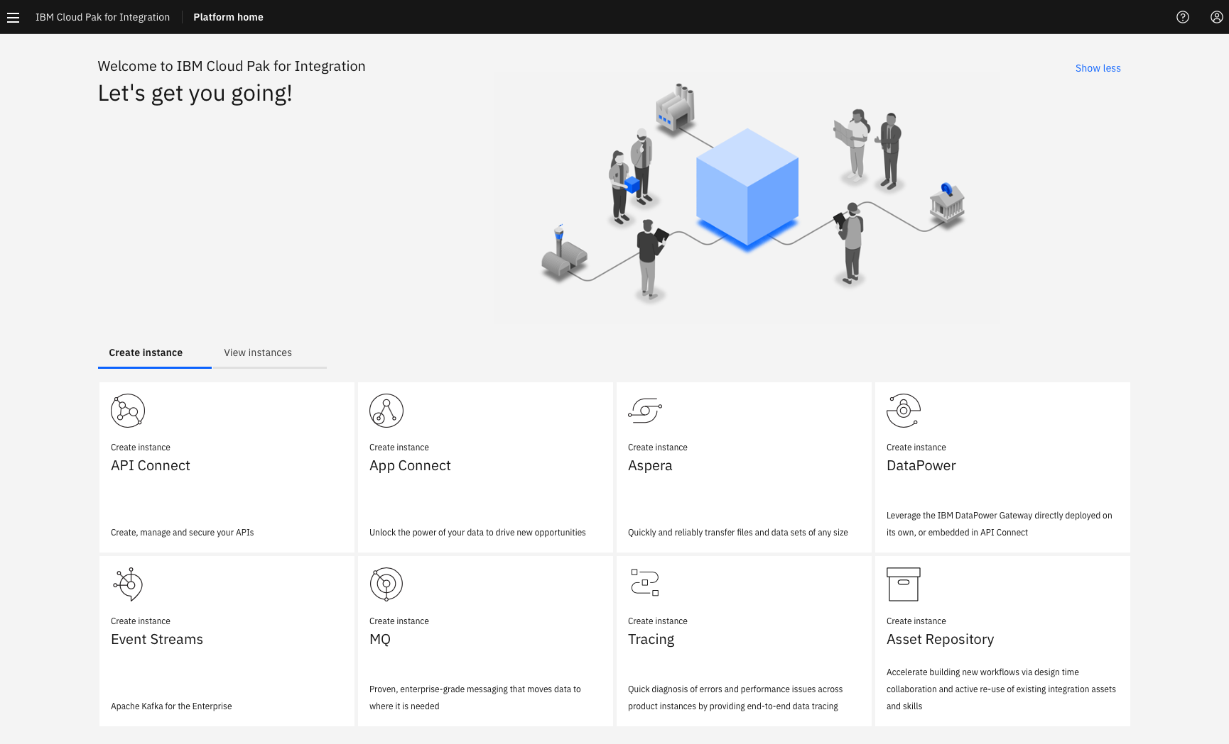
Notes:
Here’s the cloud pak for integration

Slide 22
Notes:
We’re going to focus on App Connect here

Slide 23
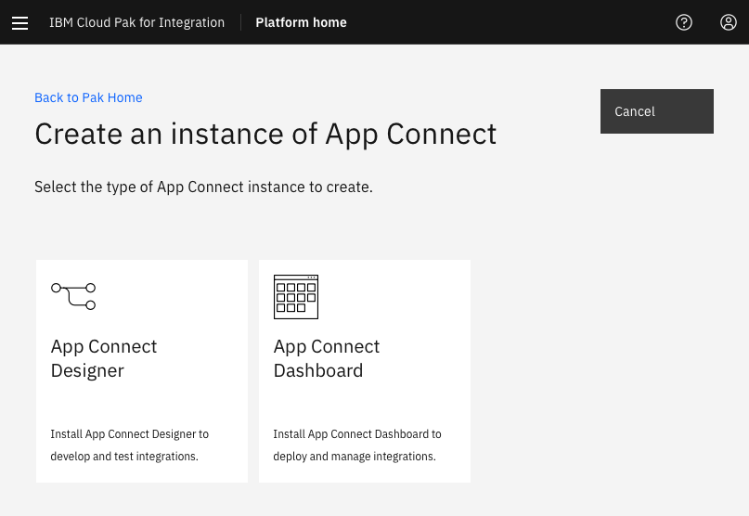
Designer==Tooling
Dashboard==Runtime
Notes:
How do I run it on the cloud pak? We need to create an instance. Designer or Dashboard?

Slide 24
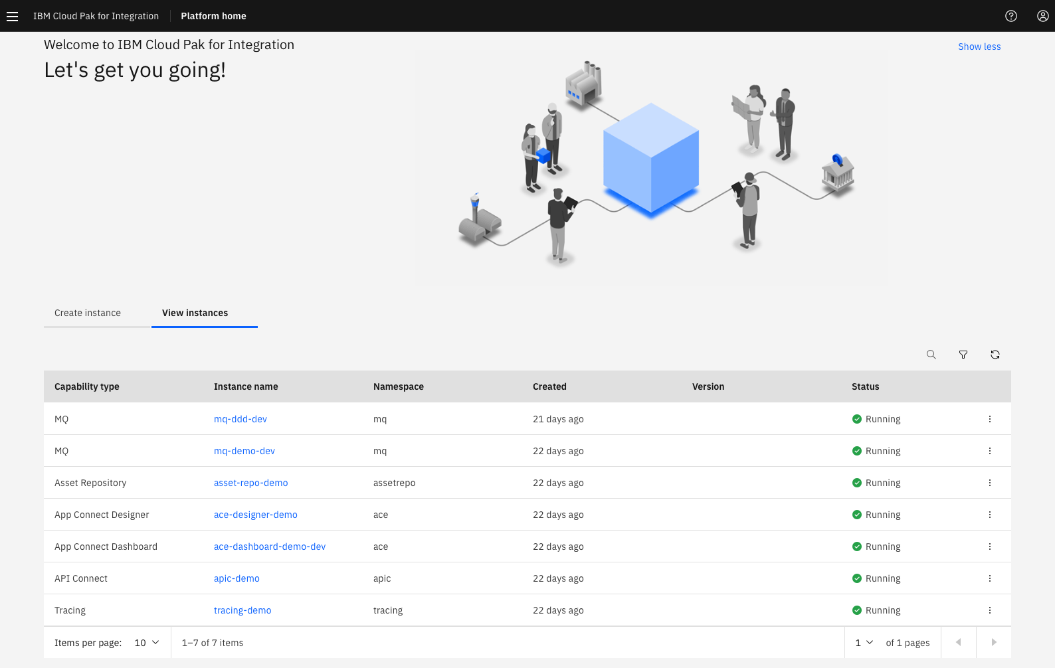
Notes:
Let’s have a look at what ‘An Instance’ actually is…

Slide 25
Notes:
We have instances and we have namespaces. We use those to create multiple separate ‘installs’ of the products. Note that the ‘Dashboard’ is an instance, which shows multiple deployment views of App Connect. We use namespaces to isolate instances but we can also have multiple instances in namespaces – with it so far?

Slide 26
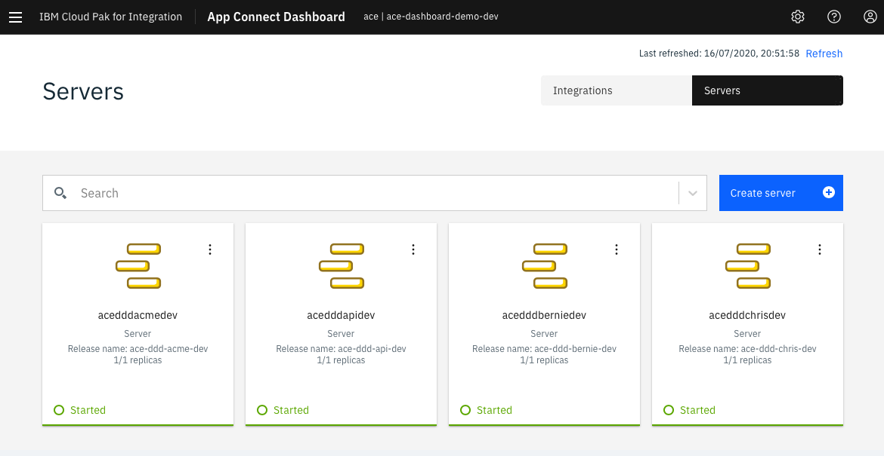
Namespace + Instance
Notes:
Just to help out – we have both integrations and servers – note that ‘integration nodes’ are not used in the cloud pak – even though k8s has nodes. Nodes is a very overloaded term.

Slide 27
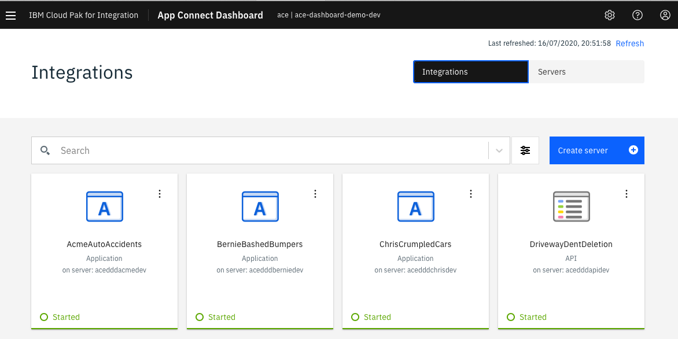

Slide 28
Replicas – how many ‘copies’ of that server are running

Slide 29
Notes:
How do we create a server? Let’s have a look

Slide 30
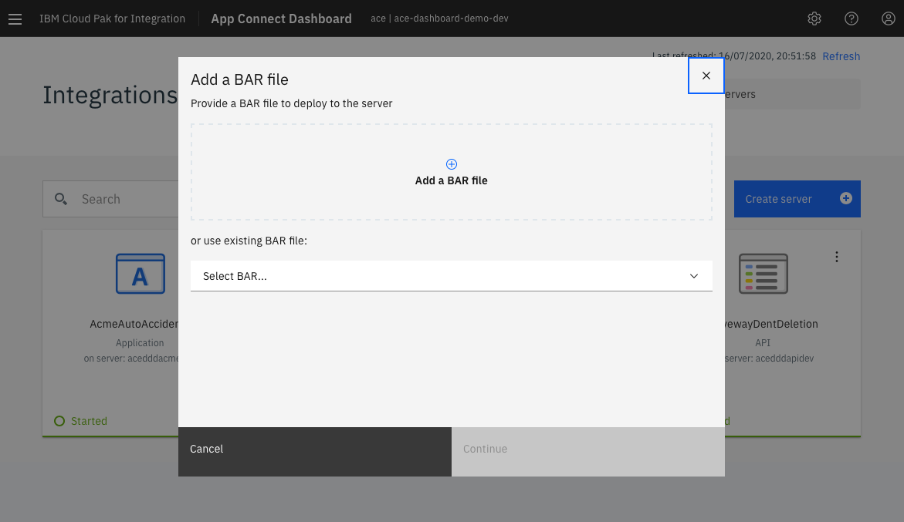

Slide 31
2020.1.1 (March)

Slide 32
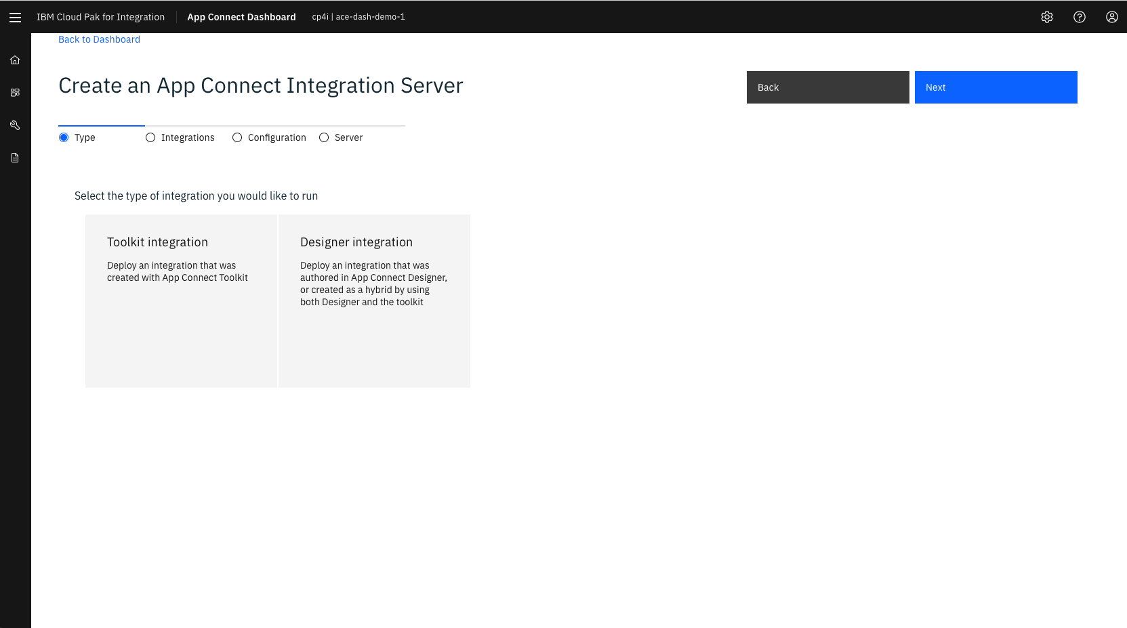
2020.2.1 (June)
Notes:
How do we create a server? Let’s have a look

Slide 33
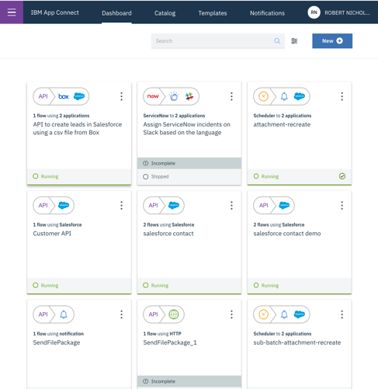
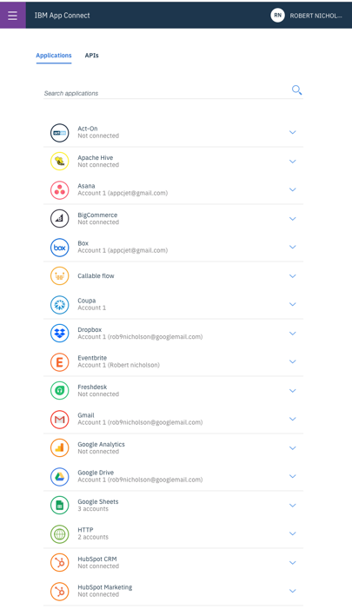
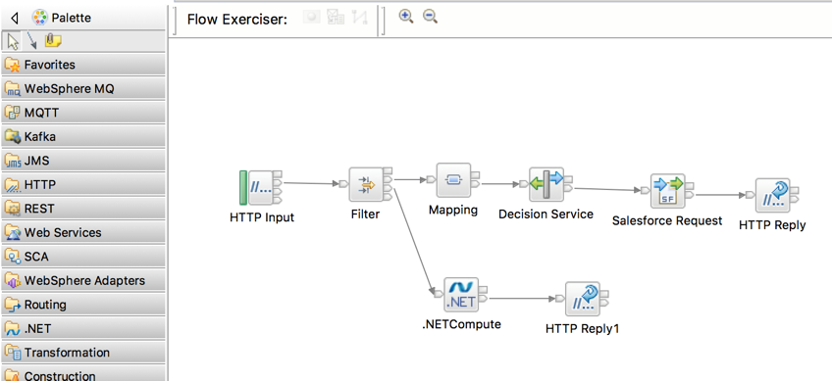
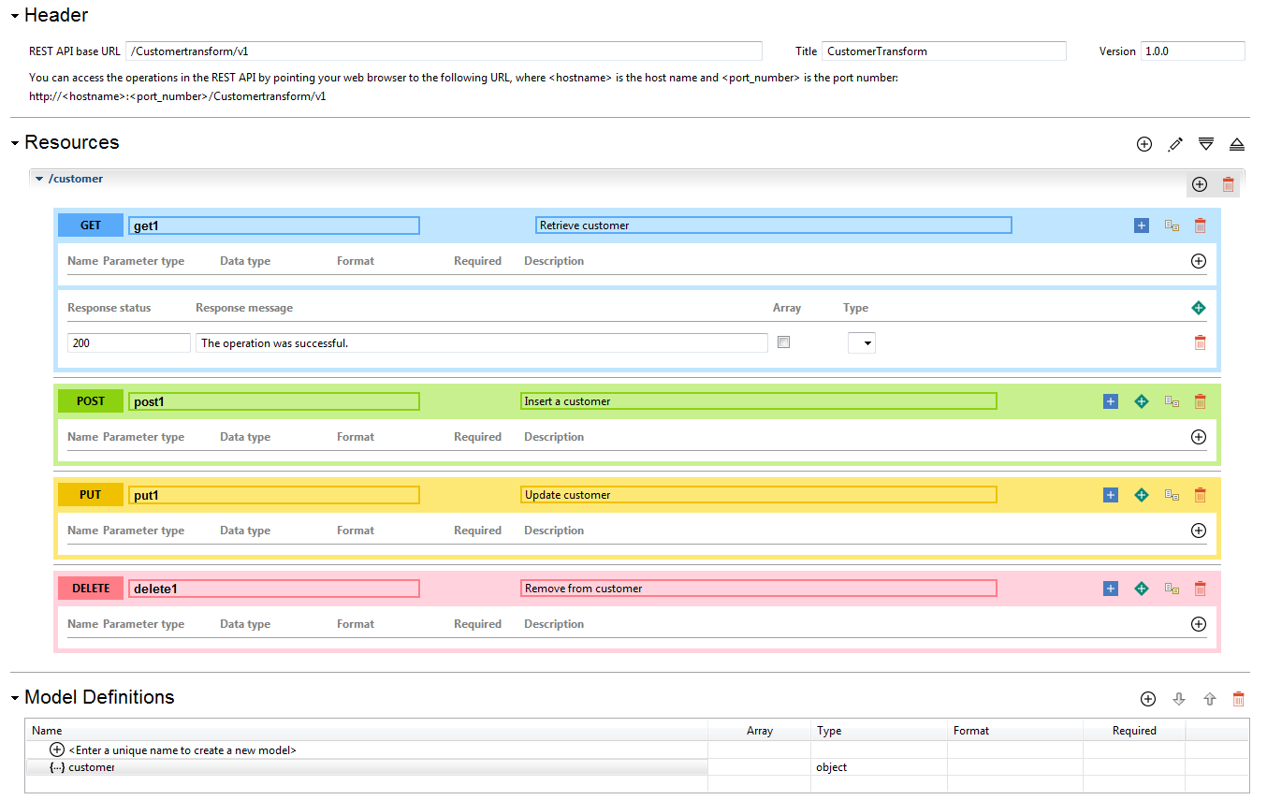
Two user experiences
The web one It let’s you do integration with zero training
The eclipse one for experts to build out the hard stuff
App Connect Designer
High Productivity
1. call shared assets
App Connect Toolkit
High Control
Award winning, browser-based design
Configuration based, model-driven tooling for rapid outcomes
Supports a broad range of use cases
2. intermingle functions
Powerful integration tooling
Build and manage integrations for any requirement
Utilize with Designer to enable greater collaboration
3. fully blended capabilities
Notes:
Well….no
We have two - Designer and Toolkit.
Designer is the web based, award-winning, configuration-based tooling that enables users with a range of skillsets to quickly connect applications, integrate data and expose APIs using a model-driven approach
Toolkit is the powerful, eclipse based tooling for skilled integration practitioners that enables them to satisfy an even broader range of use cases
The two work independently of each other, but the real value comes when you bring them, and the users using them, together.

Slide 34
Notes:
How do we create a server? Let’s have a look

Slide 35
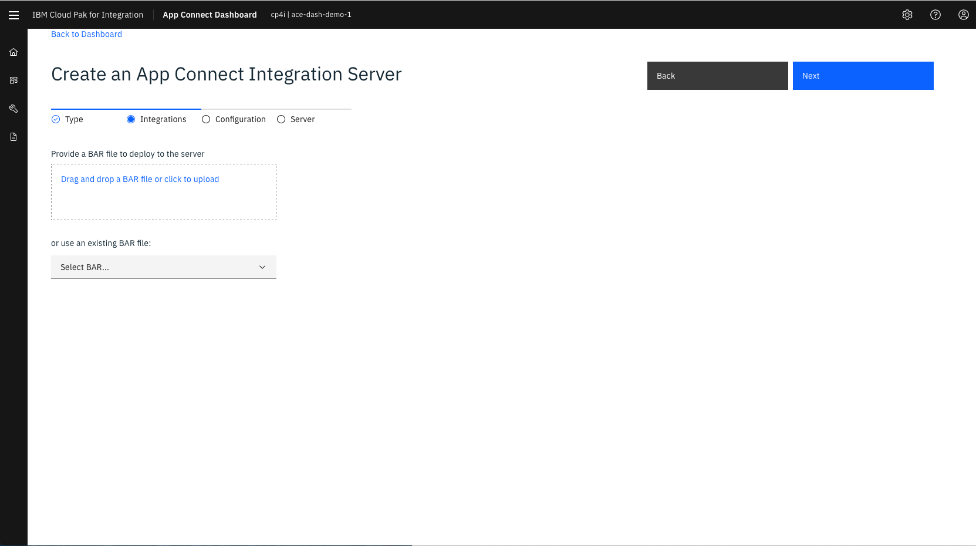

Slide 36
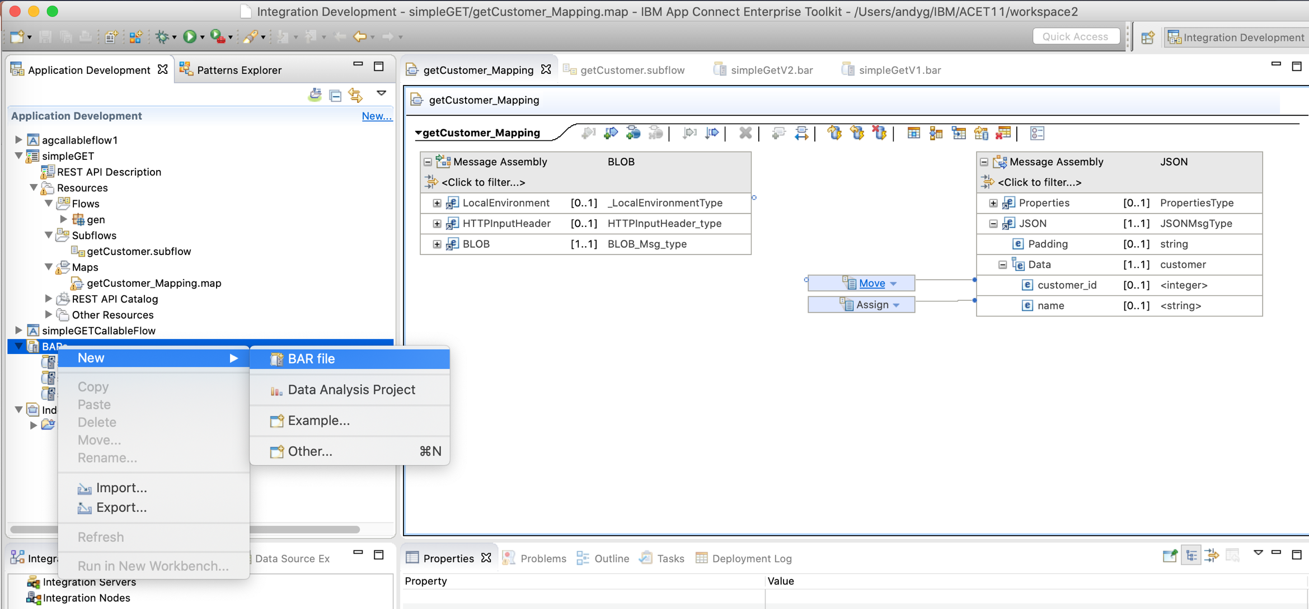
Two user experiences
The web one It let’s you do integration with zero training
App Connect Designer
High Productivity
1. call shared assets
App Connect Toolkit
High Control
Award winning, browser-based design
Configuration based, model-driven tooling for rapid outcomes
Supports a broad range of use cases
2. intermingle functions
Powerful integration tooling
Build and manage integrations for any requirement
Utilize with Designer to enable greater collaboration
3. fully blended capabilities
Notes:
Well….no
We have two - Designer and Toolkit.
Designer is the web based, award-winning, configuration-based tooling that enables users with a range of skillsets to quickly connect applications, integrate data and expose APIs using a model-driven approach
Toolkit is the powerful, eclipse based tooling for skilled integration practitioners that enables them to satisfy an even broader range of use cases
The two work independently of each other, but the real value comes when you bring them, and the users using them, together.

Slide 37
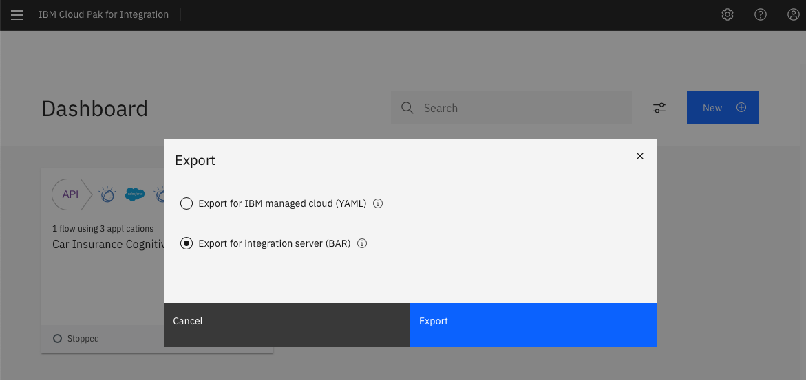
Two user experiences
The eclipse one for experts to build out the hard stuff
App Connect Designer
High Productivity
1. call shared assets
App Connect Toolkit
High Control
Award winning, browser-based design
Configuration based, model-driven tooling for rapid outcomes
Supports a broad range of use cases
2. intermingle functions
Powerful integration tooling
Build and manage integrations for any requirement
Utilize with Designer to enable greater collaboration
3. fully blended capabilities
Notes:
Well….no
We have two - Designer and Toolkit.
Designer is the web based, award-winning, configuration-based tooling that enables users with a range of skillsets to quickly connect applications, integrate data and expose APIs using a model-driven approach
Toolkit is the powerful, eclipse based tooling for skilled integration practitioners that enables them to satisfy an even broader range of use cases
The two work independently of each other, but the real value comes when you bring them, and the users using them, together.

Slide 38
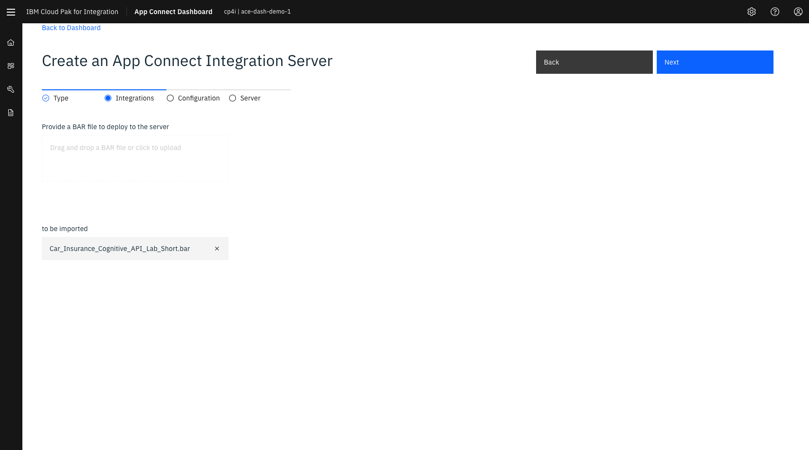

Slide 39
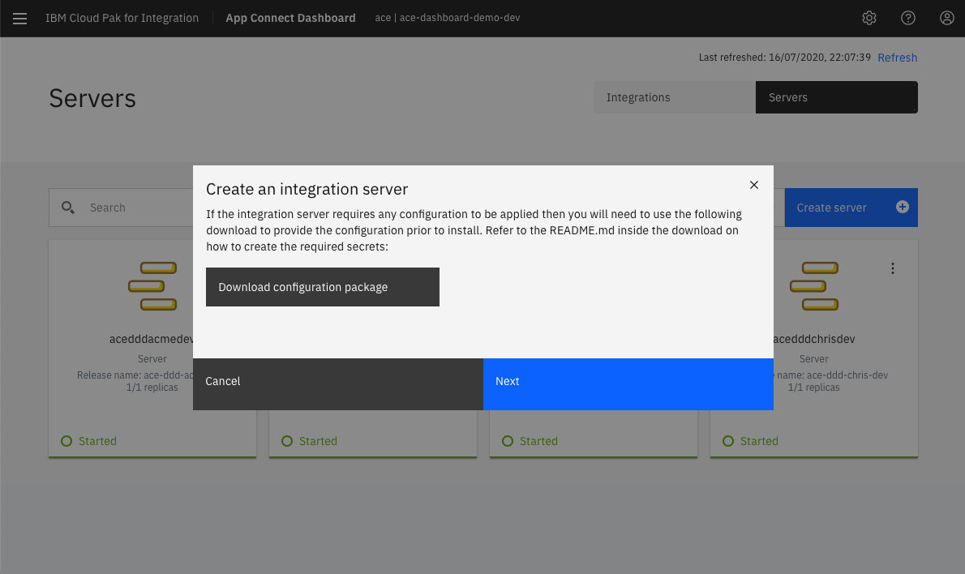
2020.1.1 (March)

Slide 40
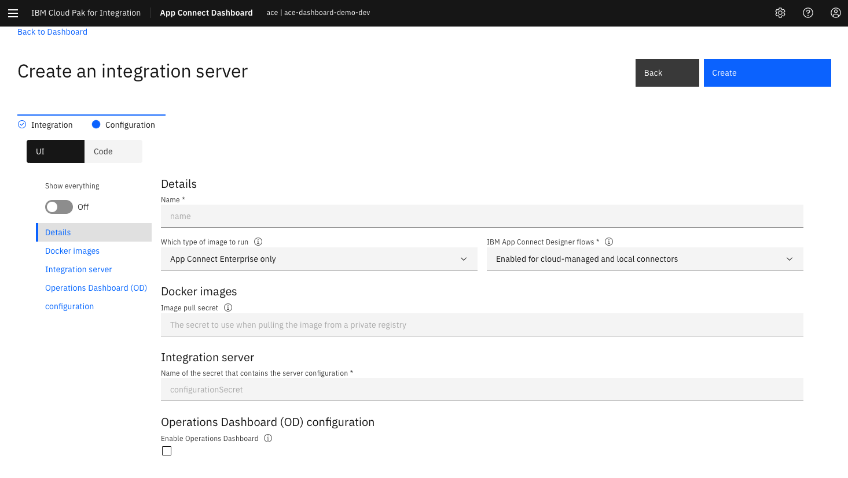
2020.1.1 (March)
For 2020.1.1 – you’d create a secret and reference it here.
That’s how you change e.g. connector credentials per environment

Slide 41
2020.1.1 (March)
Which was this config package

Slide 42
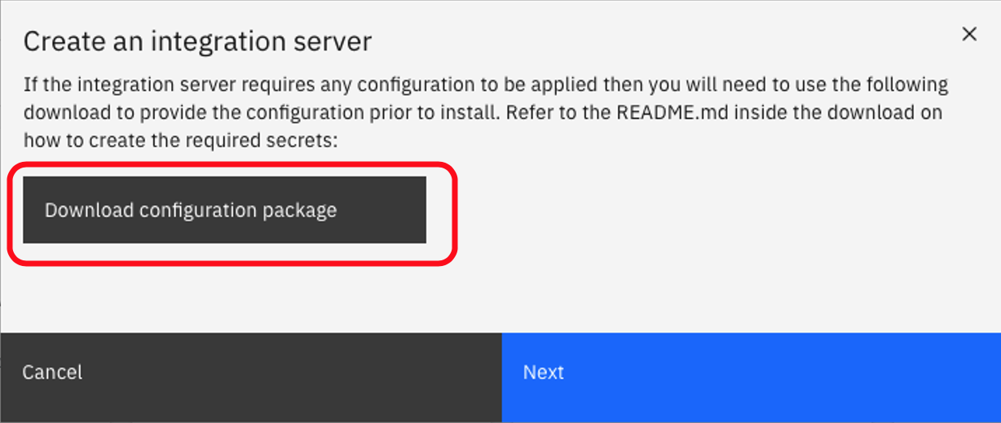
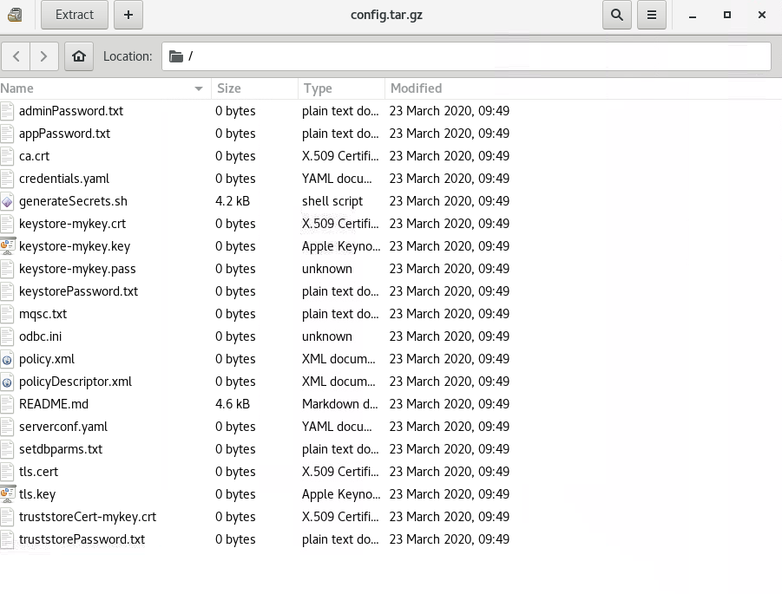
2020.1.1 (March)
Credentials.yaml== Connector Creds
generateSecrets==Creates it all for you in one go.
serverconf.yaml== override the one in the server

Slide 43
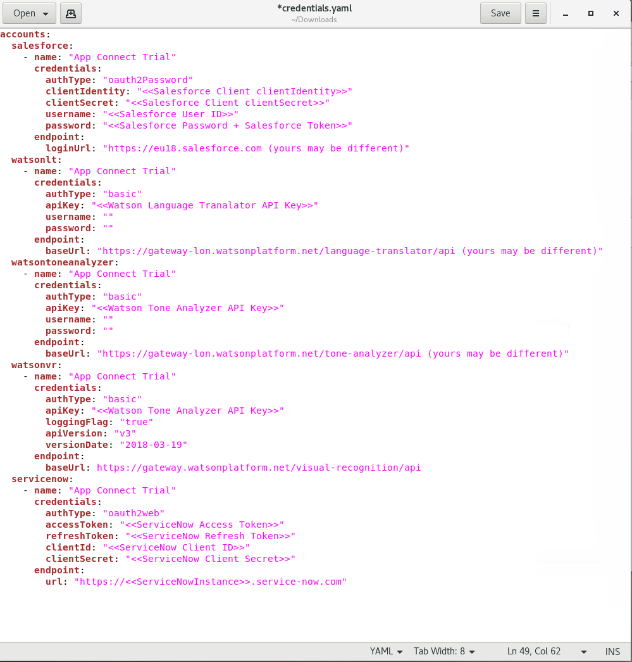
2020.1.1 (March)
“Account Name” links the credentials to the flows

Slide 44


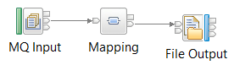
Step 2: Define your configuration points
work directory
run
Container
Image
(Immutable)
Instance
From
Application1
Message flow
Running Container
Application2
Message flow
Kubernetes
Config Maps
e.g. policies
Integrations/BARs
PolicyProject1
PolicyA
overrides
Inject at
Startup
o/s Environment Variables
File System
PolicyProject1
PolicyA
Kubernetes
Secrets
(e.g. pwds)
PolicyProject2
PolicyA
Property = {PolicyProject1}:PolicyA
Notes:
Once we have our container image, we need to define where our configuration goes.
ACE11 has policy overrides that we can use
We can override the BAR file still on container startup if we wish?
Kubernetes has config maps and secrets for us to use
Config maps can be environment variables or files – your choice!

Slide 45
Cloud Pak for Integration Makes it Easier???
Integration Technical Conference 2020
https://www.ibm.com/cloud/cloud-pak-for-integration
Notes:
And we’ll fix this slide up! Note our cool new interface!

Slide 46
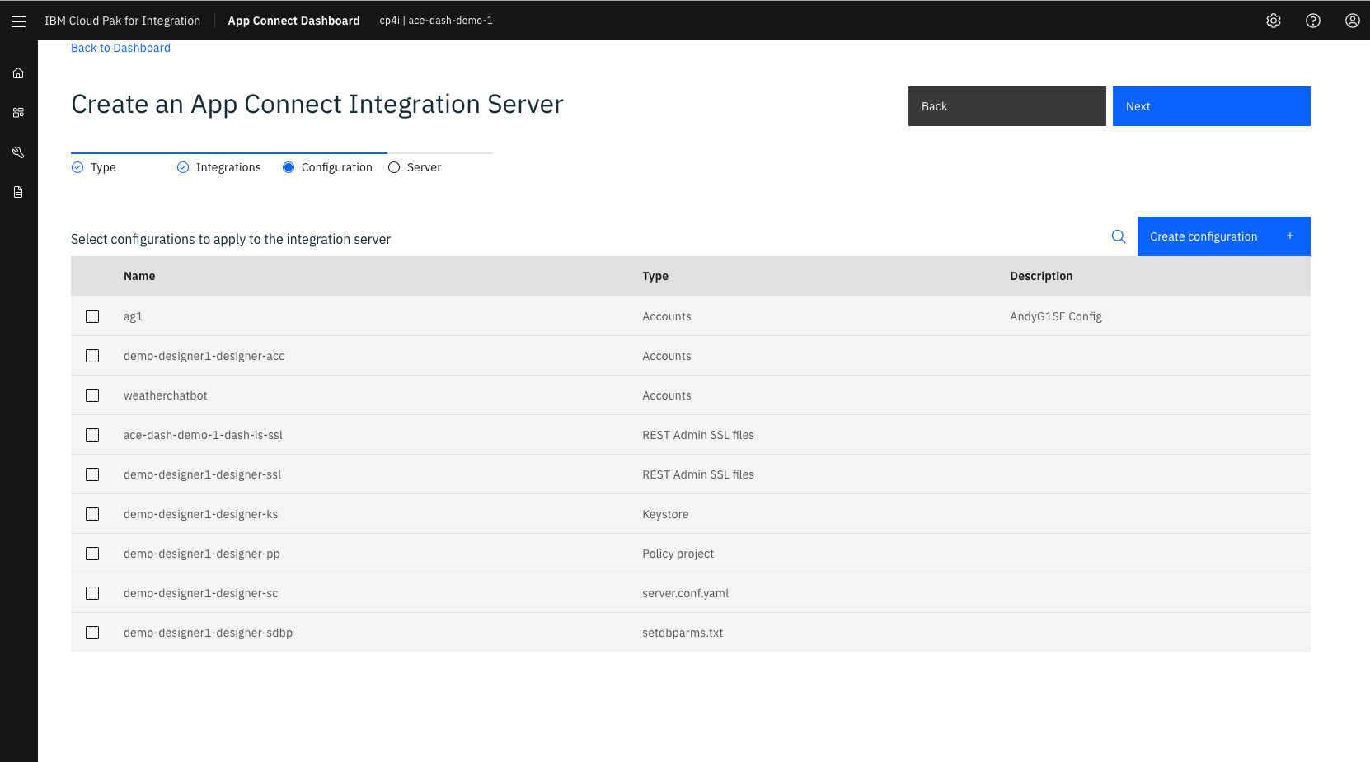
2020.2.1 (June)
We now use configurations which can be edited right in the UI

Slide 47
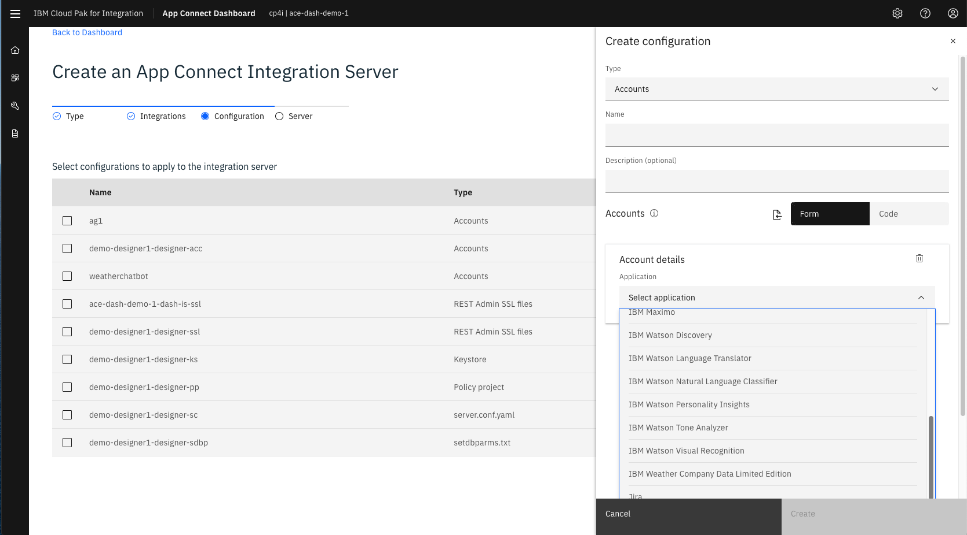
2020.2.1 (June)
Select your connectors and add the connection details

Slide 48
2020.2.1 (June)
You can now use the same accounts you set up in designer!

Slide 49
2020.2.1 (June)
And not just connector credentials

Slide 50
“Design is a plan for arranging elements in such a way as best to accomplish a particular purpose.” Charles Eames The Information Machine, 1964

Slide 51
“Design is a plan for arranging elements in such a way as best to accomplish a particular purpose.” Charles Eames The Information Machine, 1964
This is straight out of the conference template:
I didn’t change a word..
For Cloud Paks / Kubernetes / OpenShift:
“Make it look like this”, not “Please perform these steps”

Slide 52
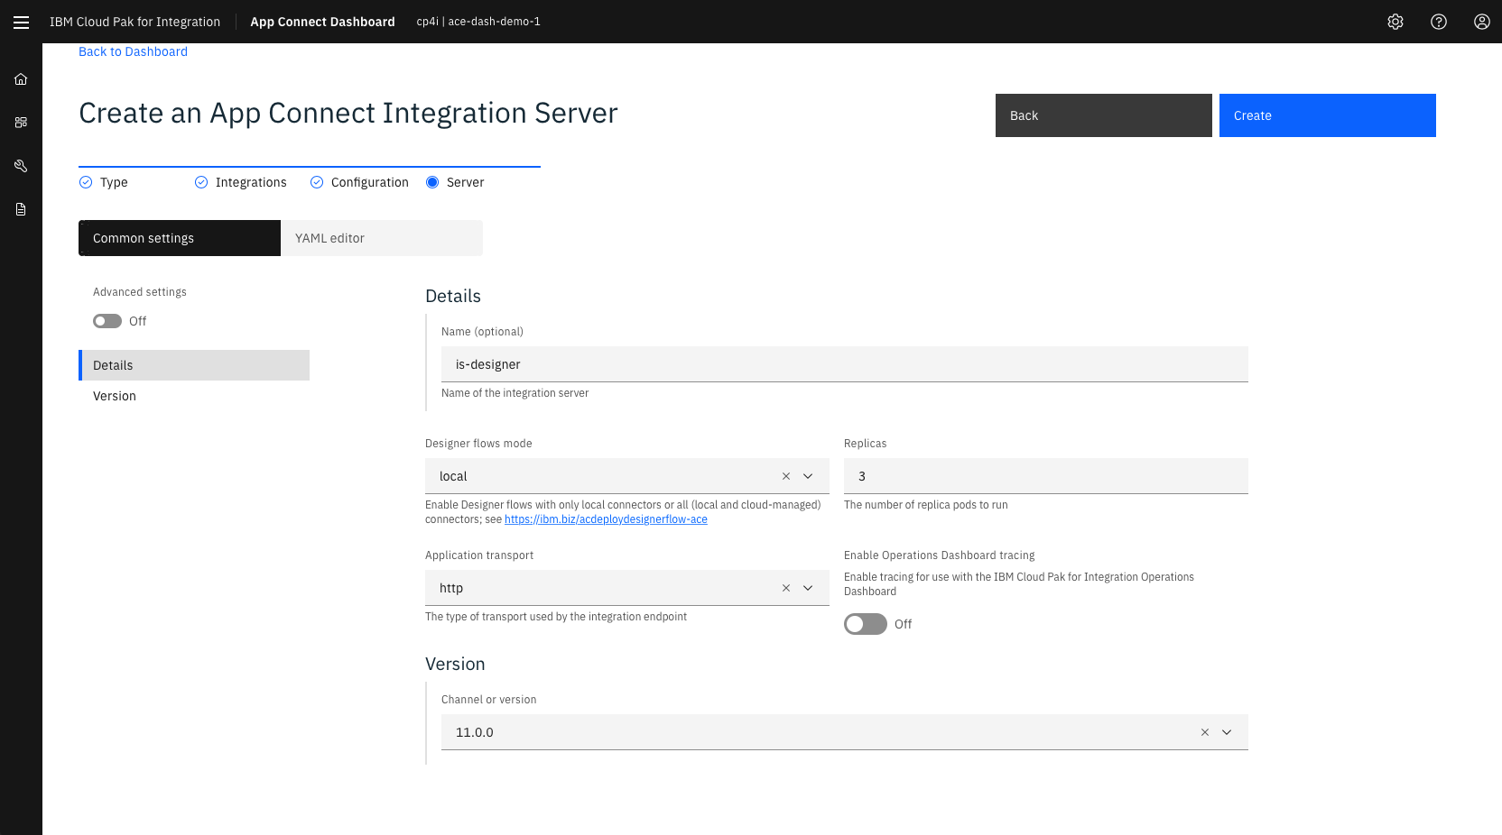
Notes:
The key thing here is we are saying ‘Make it look like this’ not ‘Please do this, then this, then this’

Slide 53
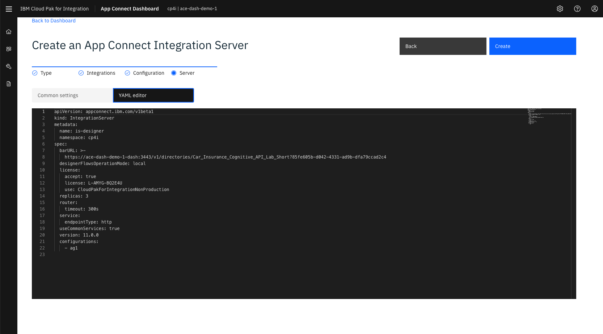
YAML code are UI are the same information

Slide 54
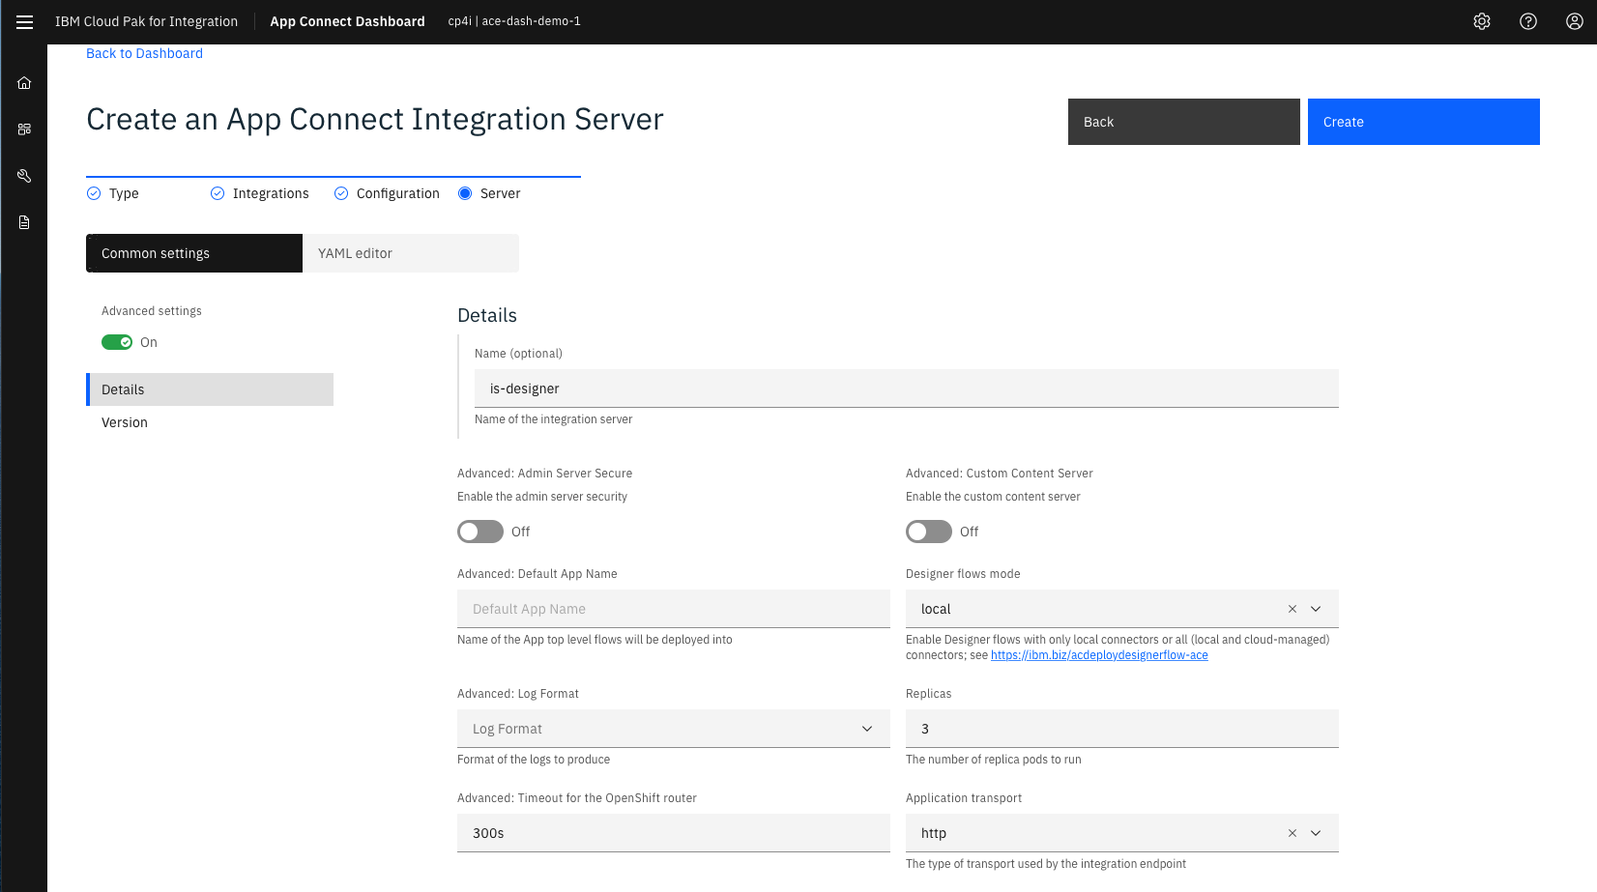

Slide 55

Anatomy of a container:
Container Image
Anything else
Helpers and Utilities
Static Configuration
Integrations (BARs)
App Connect
Operating System
Notes:
A container has a number of layers. Each of these layers builds on the previous ones – a kind of inheritance model.
So we build up all of our layers to make sure we have all of the content and capabilities we need when we run it.
Containers are lightweight – don’t put things in ‘just in case’. Containers are ephemeral, you can create a new one.
(The image is like a class – when it runs it’s like an instance)

Slide 56
Go simple and big if possible
Notes:
Let’s just fix that up to be relevant here

Slide 57
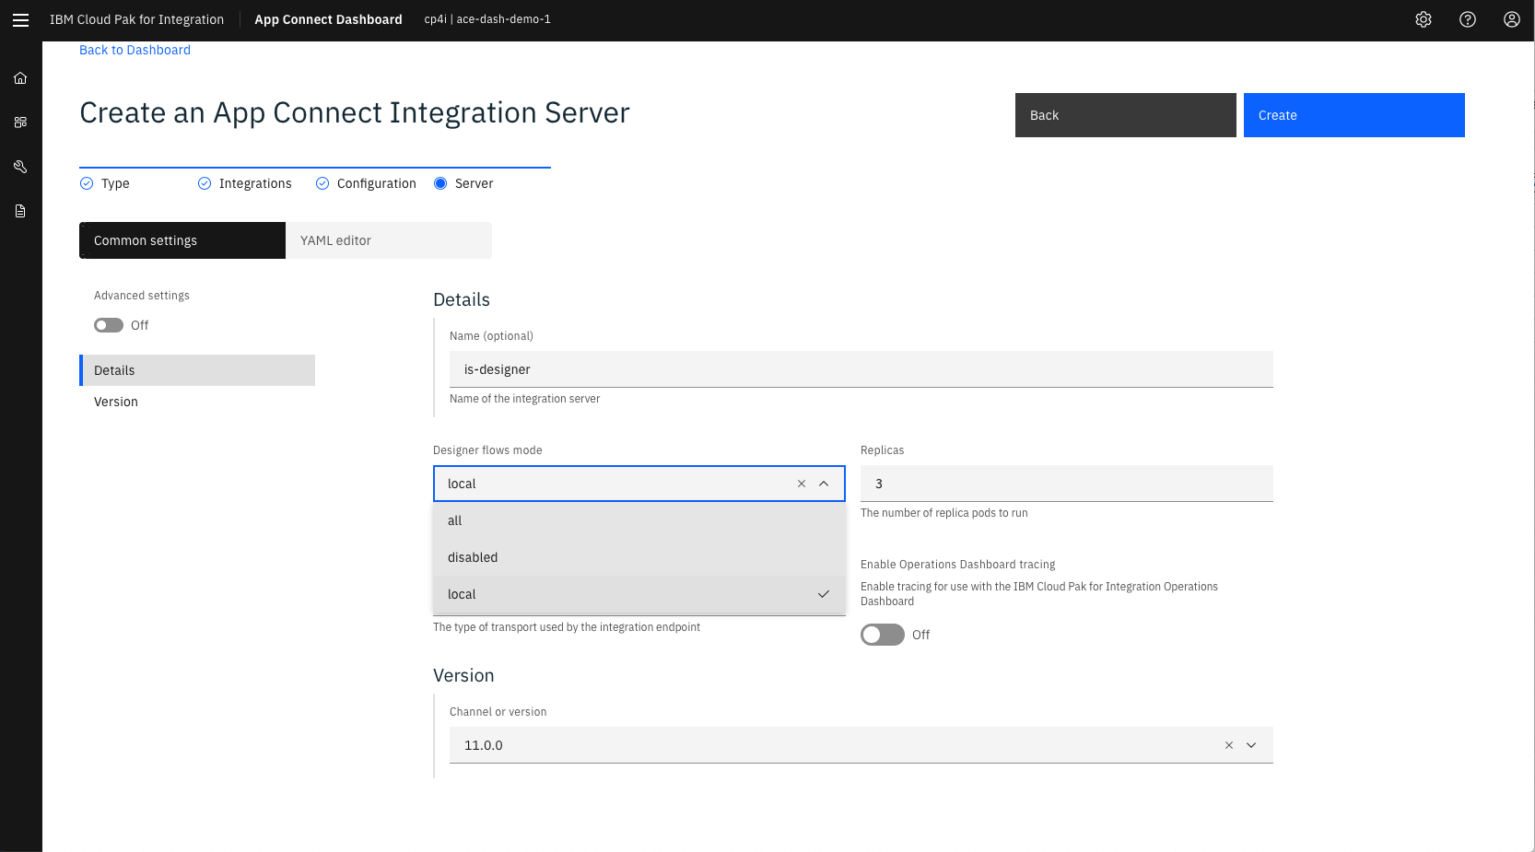
Where to run the connectors for designer flows?

Slide 58
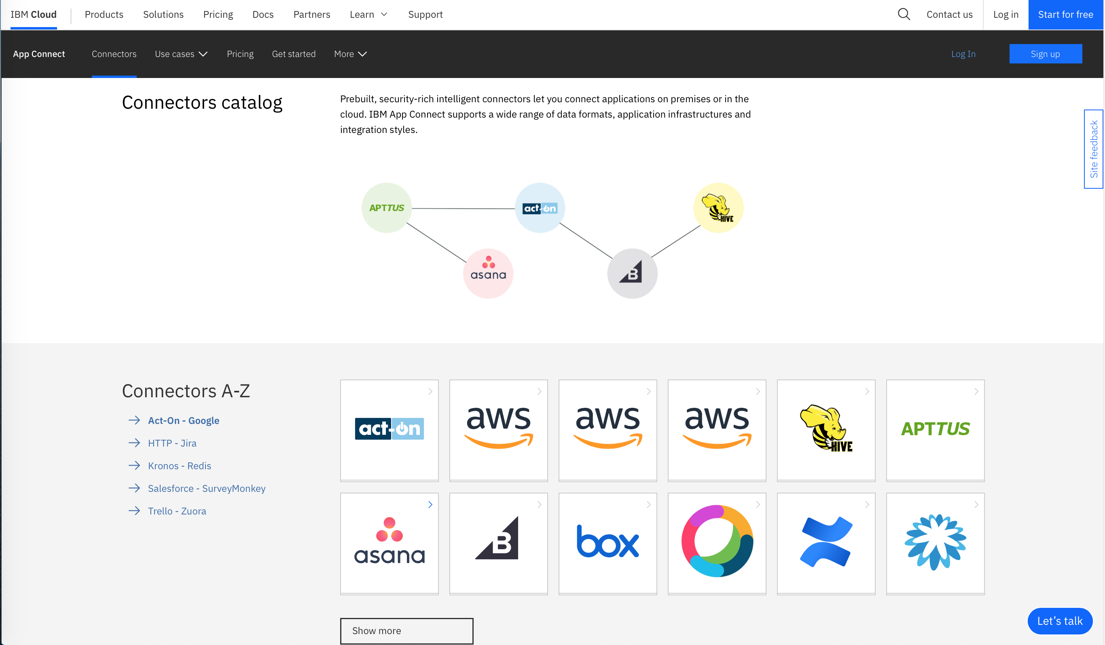
You can run your connectors ‘Locally’ on ICP4i
Or you can configure and run your connectors on the IBM cloud

Slide 59
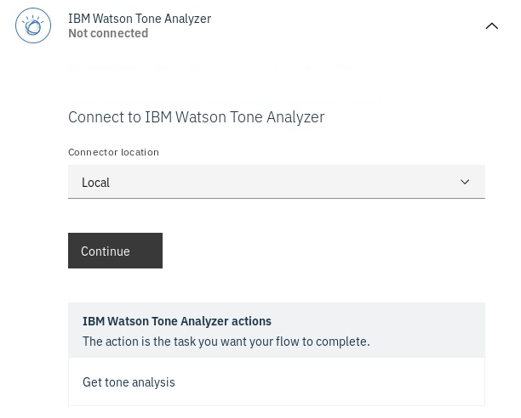

If you add ‘cloud connectors’ to designer, you’ll be asked which you want when you configure your accounts
Running in the IBM cloud means that’s where you configure credentials etc
You’ll need to supply an IBM cloud API key for this

Slide 60
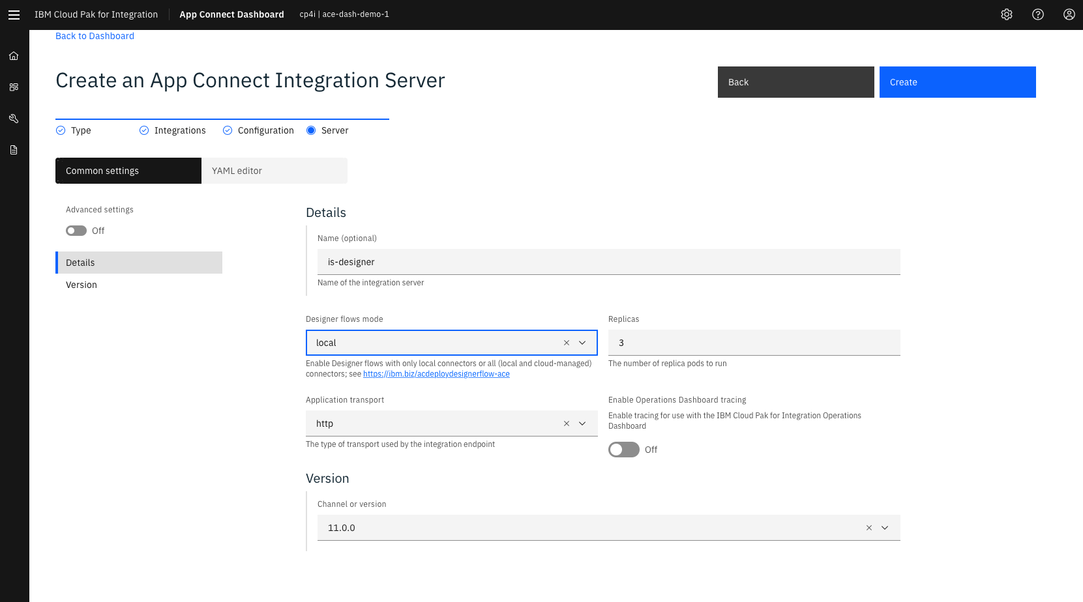
Built in HA and scaling Replicas right up at the top!

Slide 61
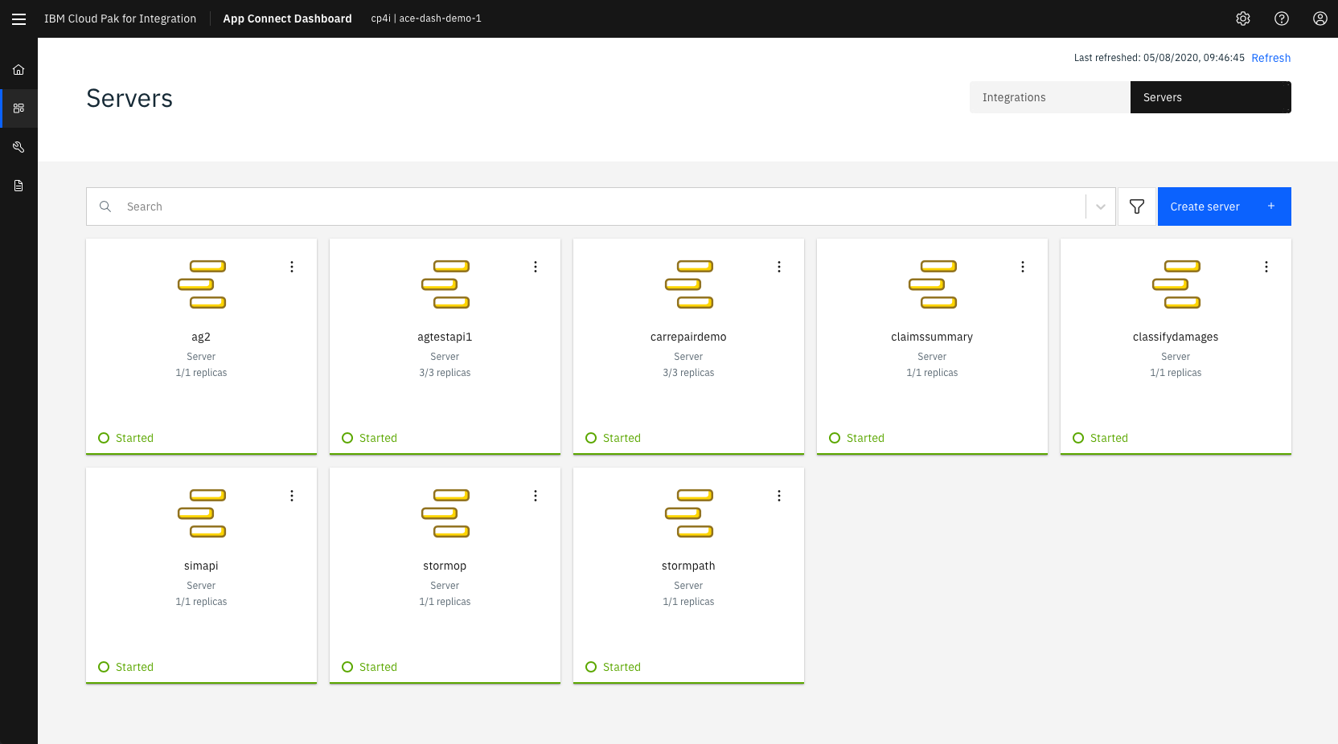

Slide 62
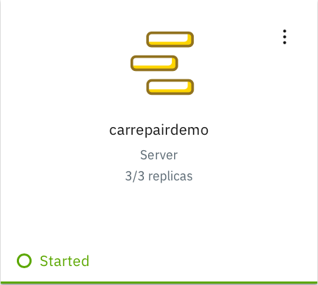

Slide 63
Enable tracing? Just click

Slide 64
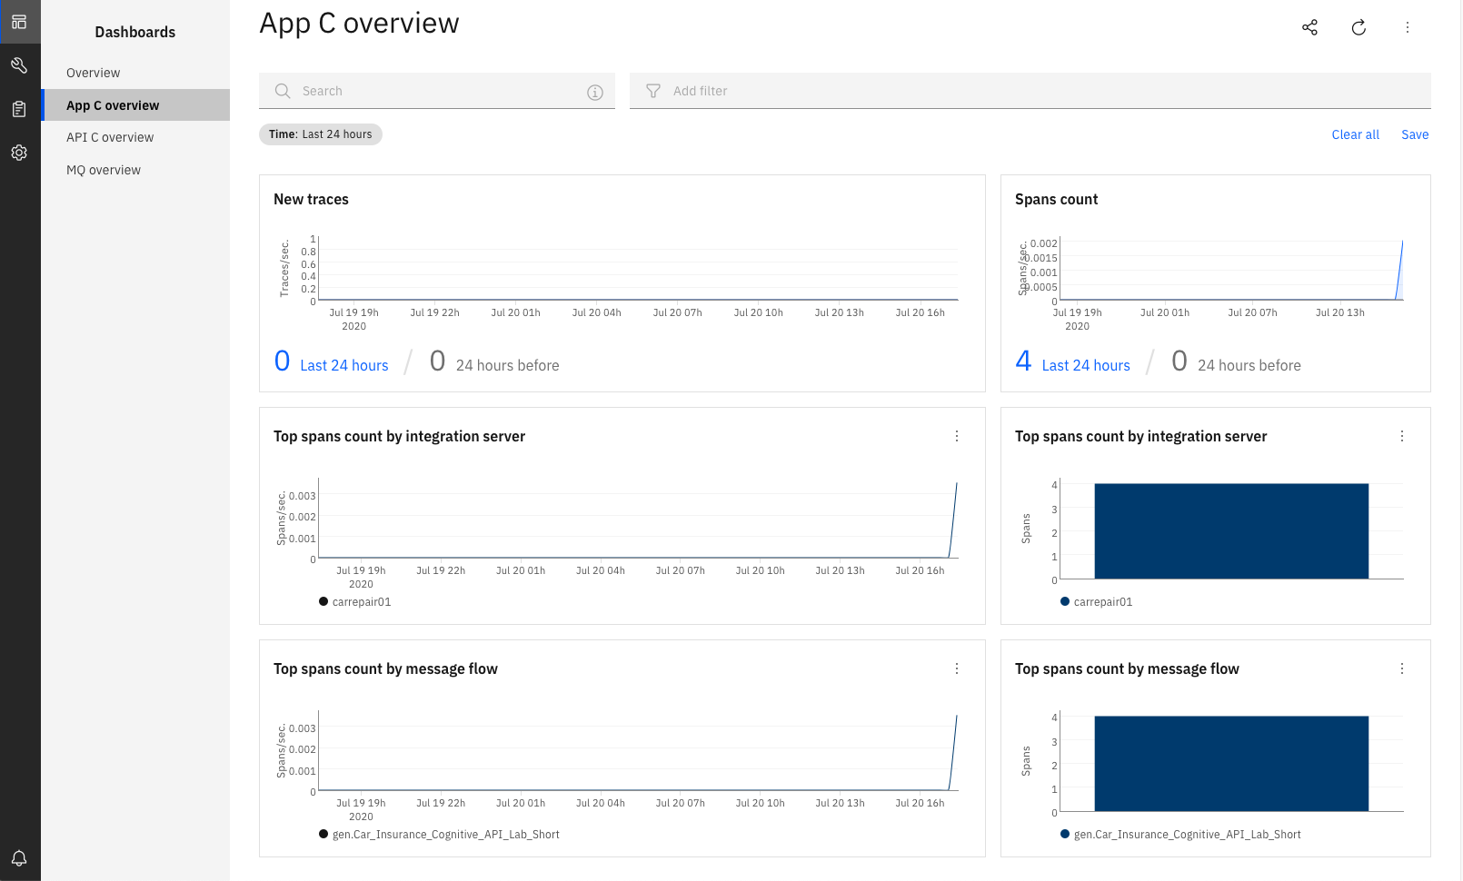
Tracing is across products

Slide 65
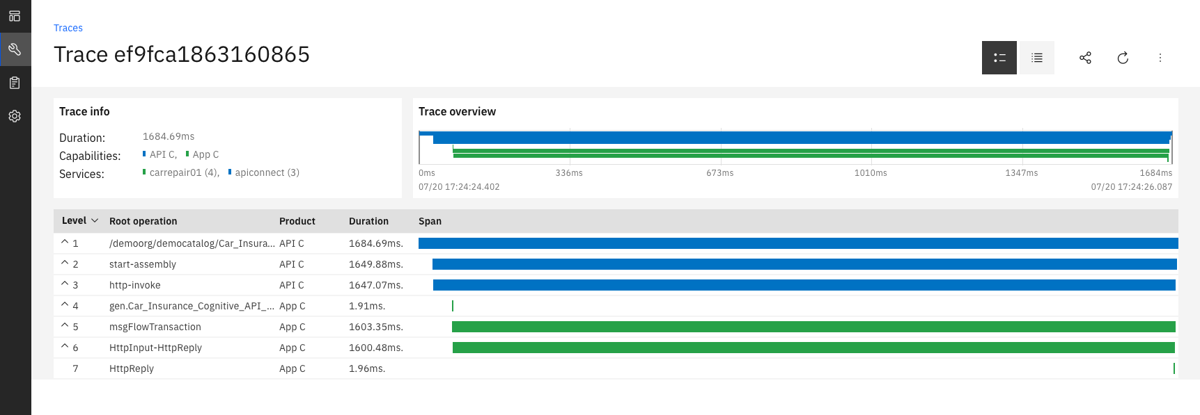
You can see your trace across multiple components – here’s API Connect calling App Connect
Traces out the operations with timings etc

Slide 66
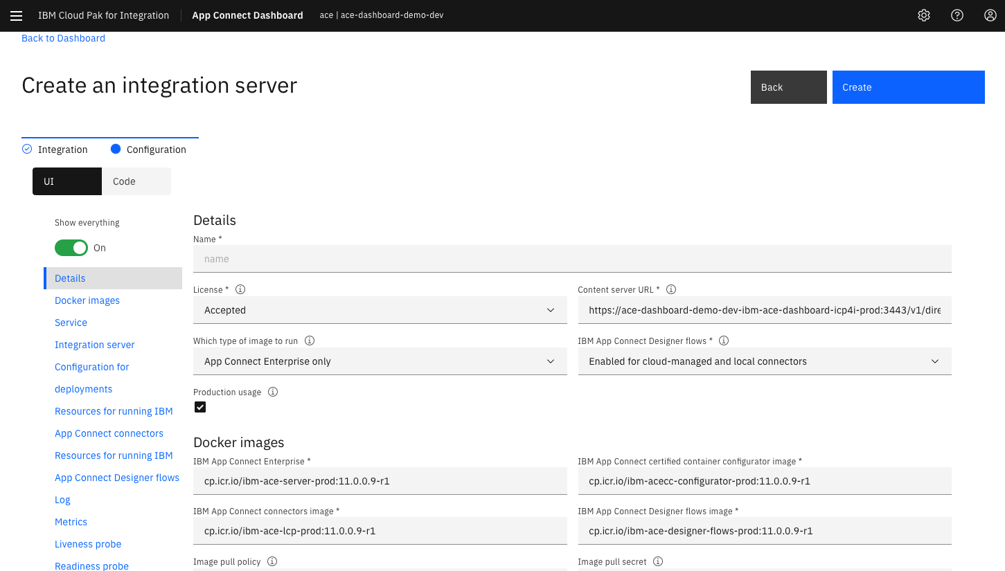
2020.1.1 (March)
Allows you to select different ACE versions!
Which container images do you want to use?

Slide 67
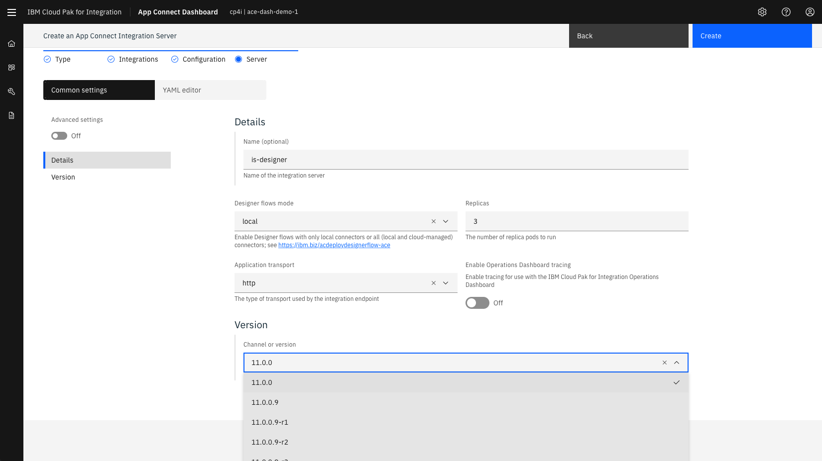
2020.2.1 (June)
Now just select the version you want
Or choose a channel – and get ‘latest’

Slide 68
Which allows us to do this…
ESB: ACE V11.0.0.0
ACE V11.0.0.8
ACE V11.next
ACE V11.next
MQ
Flow A V1
Flow B V1
Flow C V1
Flow D V1
MQ
Flow B V3
MQ
MQ
Flow D V3
Flow W V3
ACE V11.next
ACE V11.0.0.8
ACE V11.next
ESB: ACE V11.0.0.0
ACE V11.next
MQ
Flow R V3
MQ
Flow T V1
Flow U V1
Flow Q V3
Flow S V3
Flow X V3
Notes:
If we got them really small, just think how many we could have - we'd have true independence!

Slide 69
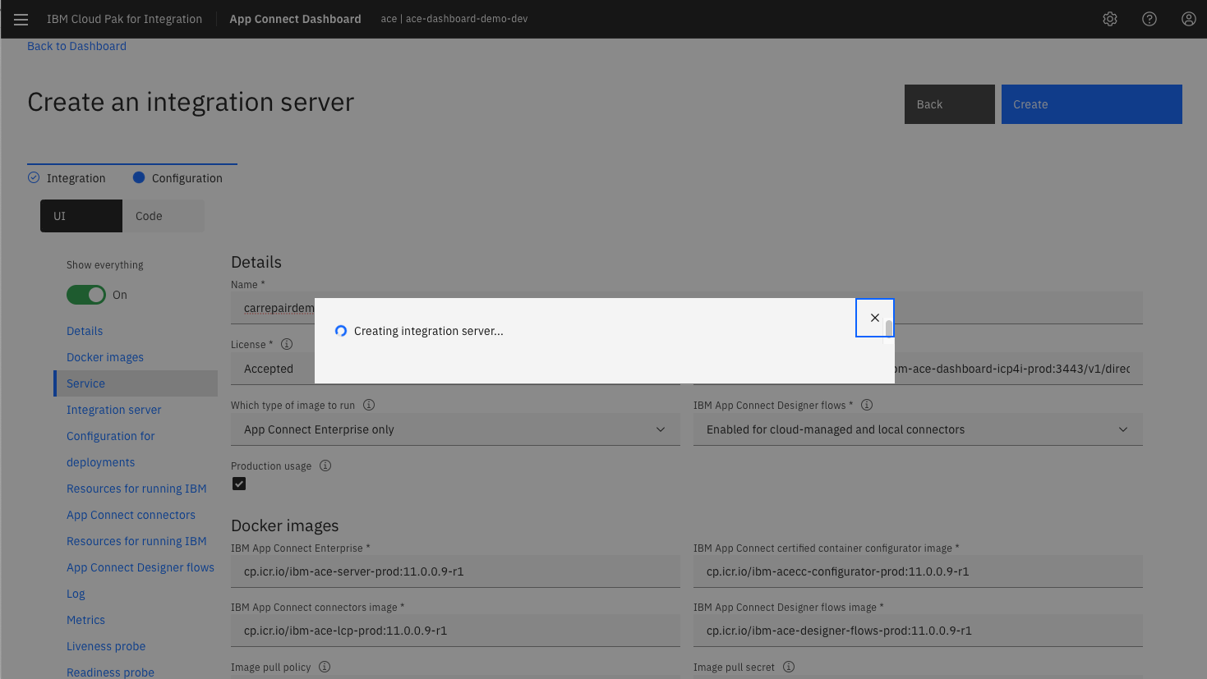
2020.1.1 (March)
It was too quick to get a screenshot for 2020.2.1!

Slide 70
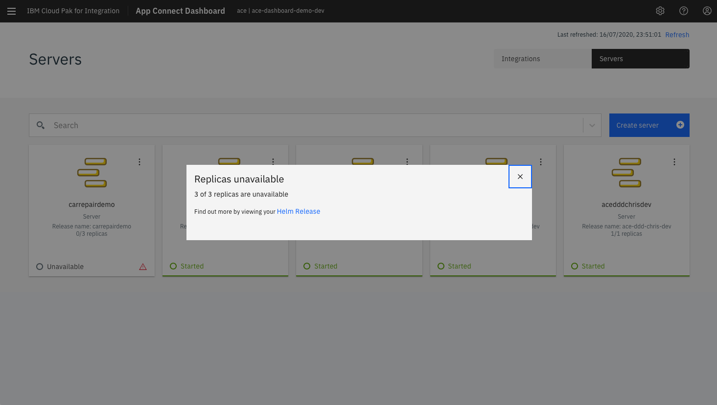
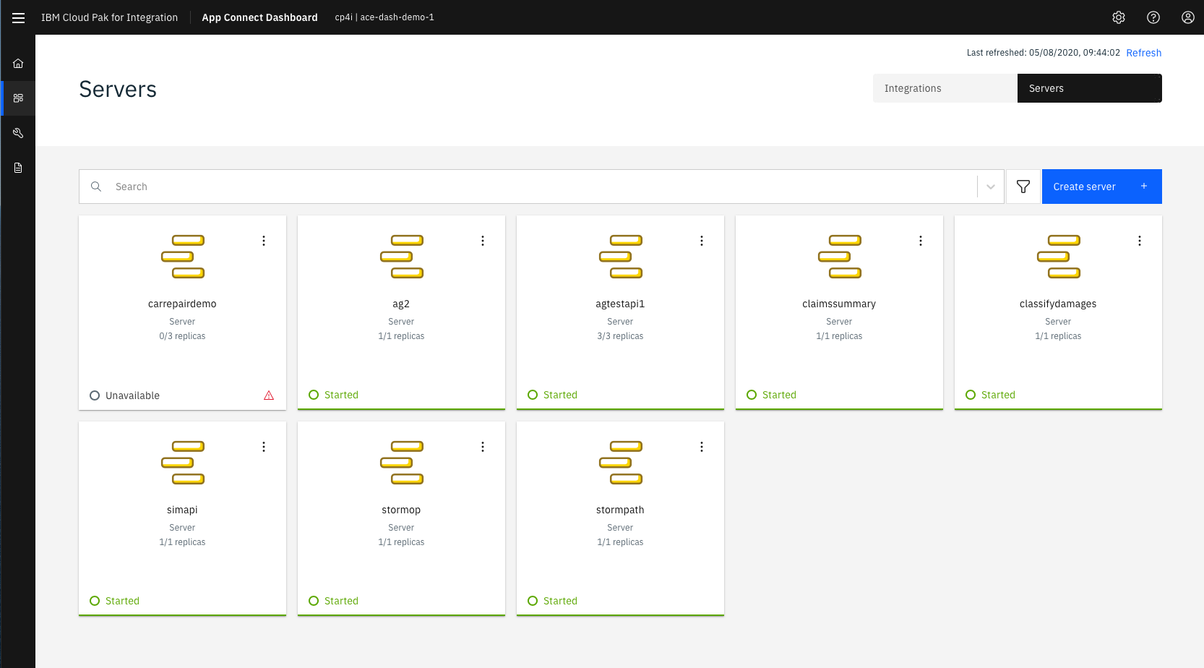
A ‘Helm Release’ is related to a Deployment
This does not mean ‘It’s broken’ – it means ‘not available yet’

Slide 71
2020.1.1 (March)
A ‘Helm Release’ is related to a Deployment
This does not mean ‘It’s broken’ – it means ‘not available yet’

Slide 72
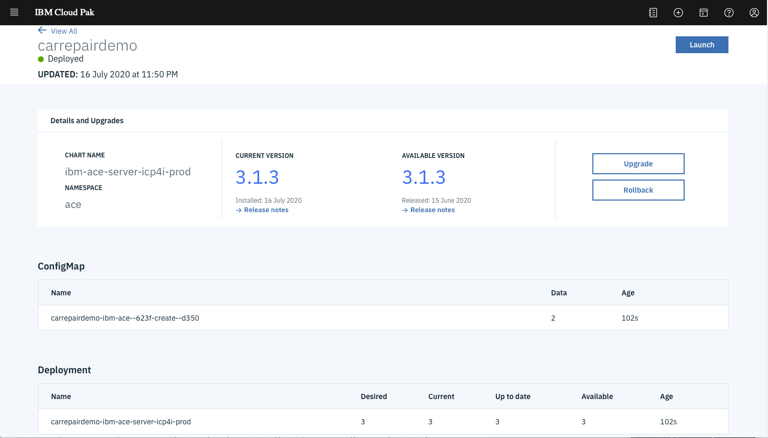
2020.1.1 (March)
For 2020.1.1 – go and look at the Helm release
Number of replicas. Note ‘I would like’ vs ‘What you currently have’

Slide 73
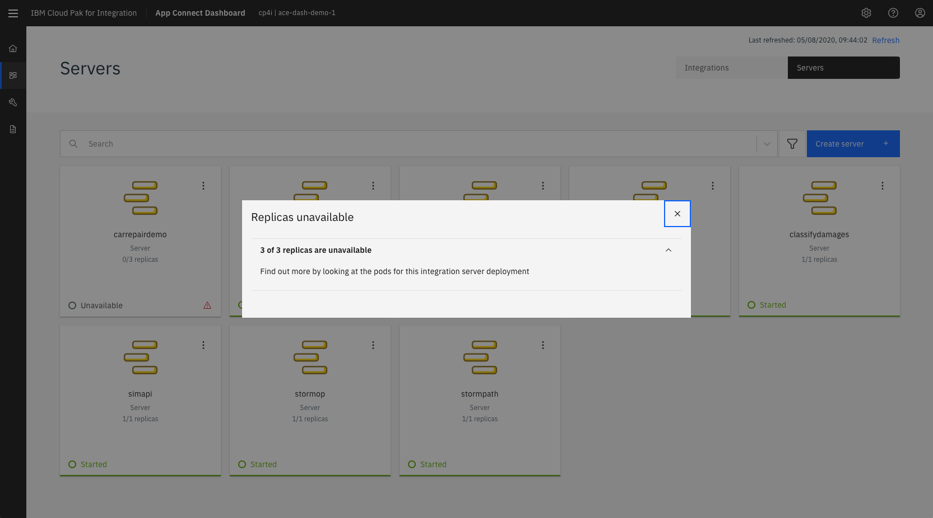
2020.2.1 (June)
A ‘Helm Release’ is related to a Deployment
This does not mean ‘It’s broken’ – it means ‘not available yet’

Slide 74
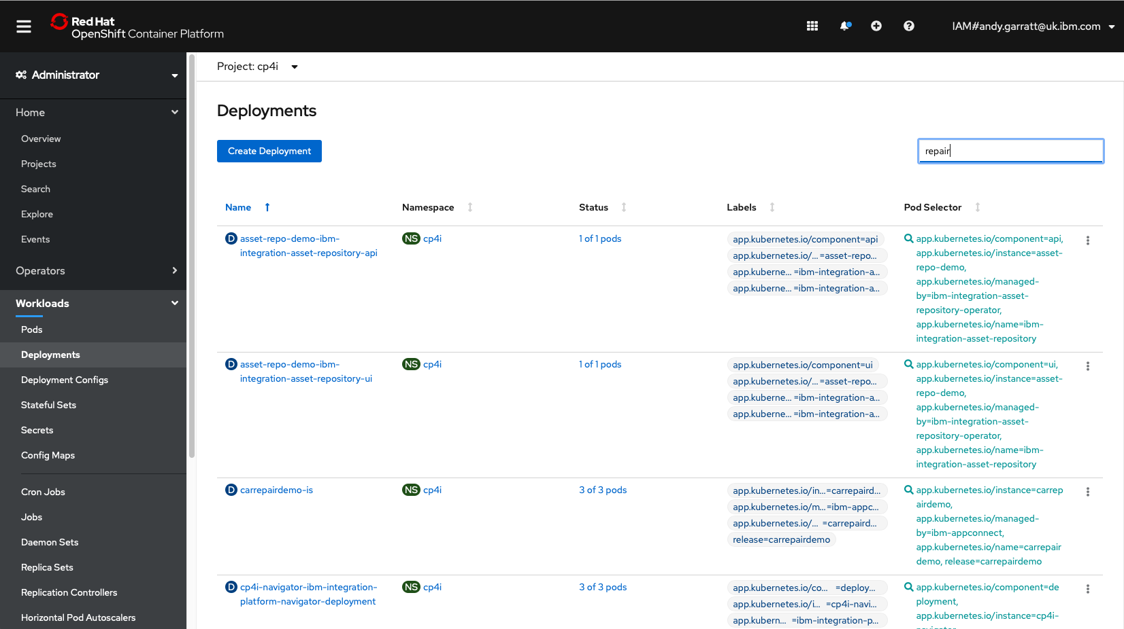
2020.1.1 (March)
2020.2.1 (June)
For 2020.2.1, using Operators – go to Openshift Deployments
Number of replicas. Note ‘I would like’ vs ‘What you currently have’

Slide 75

This deployment is now available – note the number of replicas

Slide 76
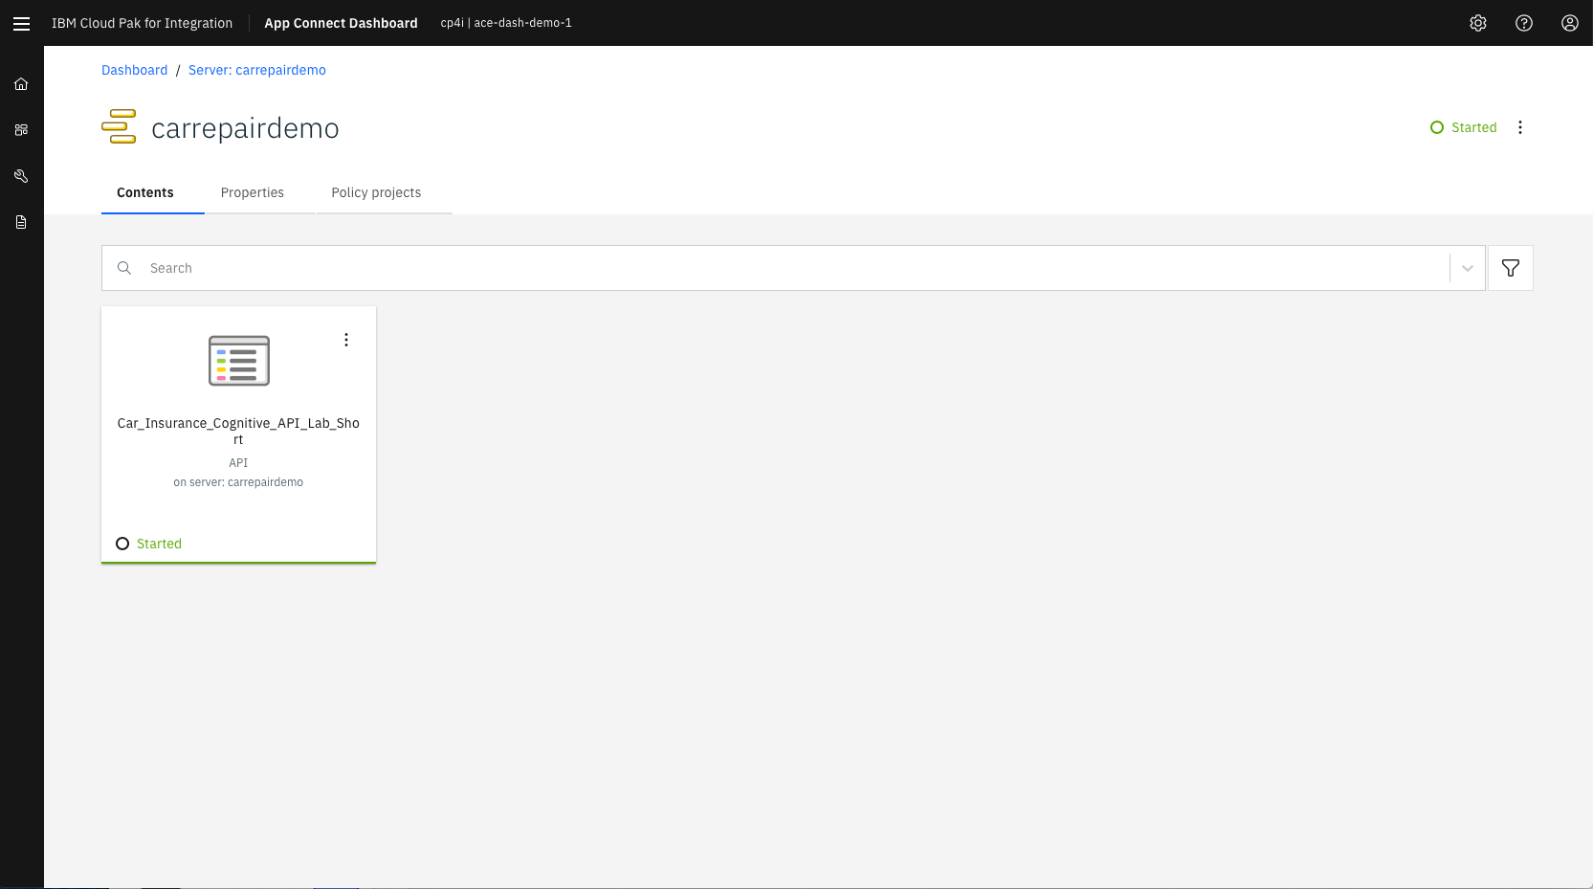
This deployment is now available – note the number of replicas

Slide 77
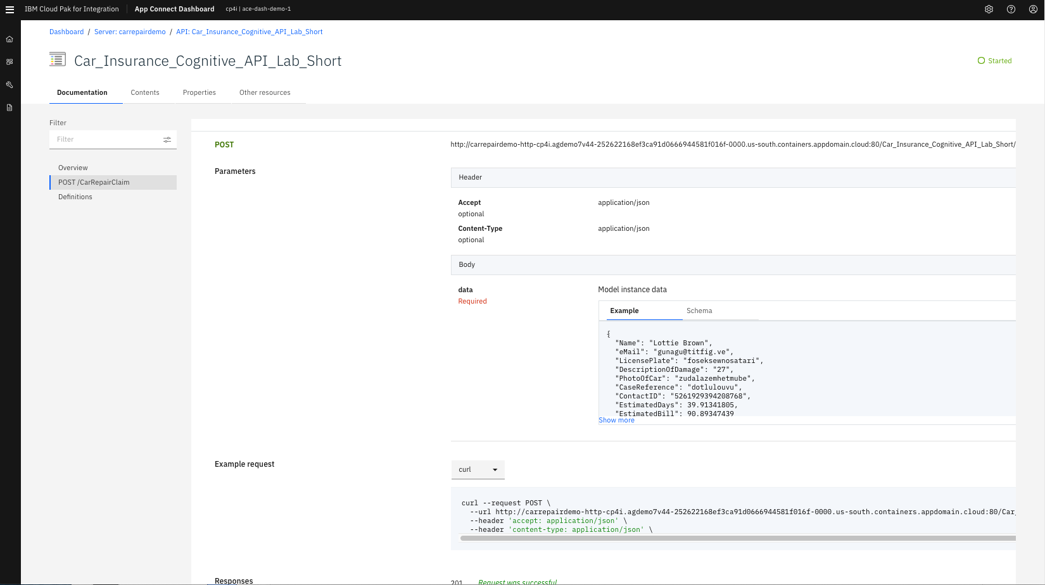
Now gives graphical view of the OpenAPI spec
Sample Data
Code samples in multiple languages

Slide 78
2020.1.1 (March)
2020.2.1 (June)
For 2020.2.1, using Operators – go to Openshift Deployements
Number of replicas. Note ‘I would like’ vs ‘What you currently have’

Slide 79
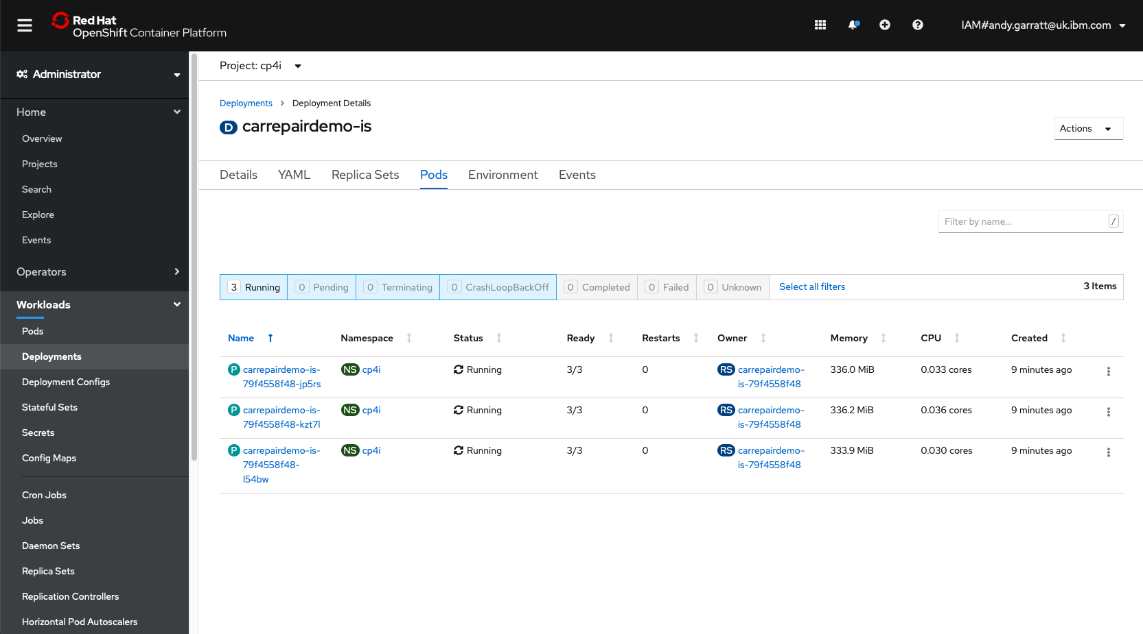
Number of pods = number of replicas

Slide 80
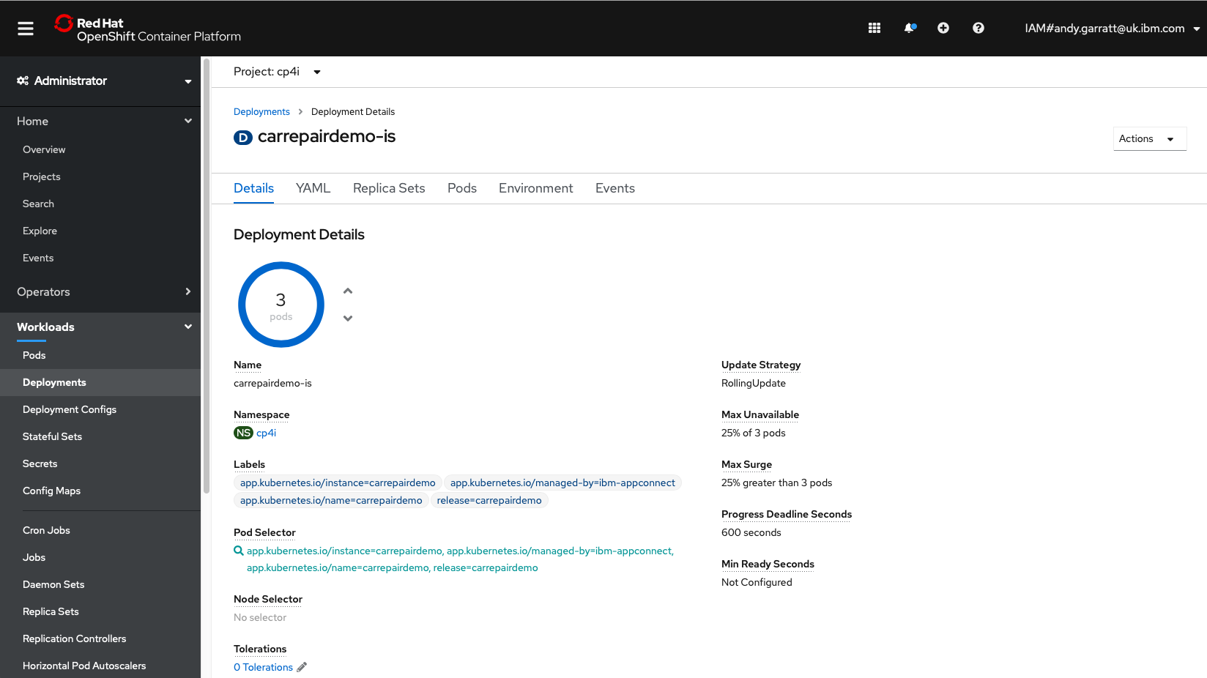
Change the number up and down from here – or change it in the operator
Rolling update – keep it live at all times

Slide 81
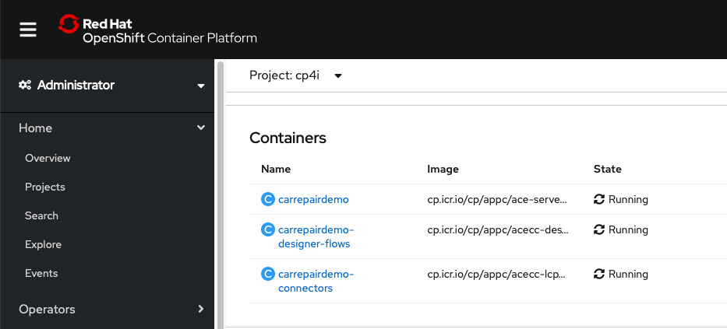
One Pod==N containers
Integration Server
Designer Flows
Connectors

Slide 82
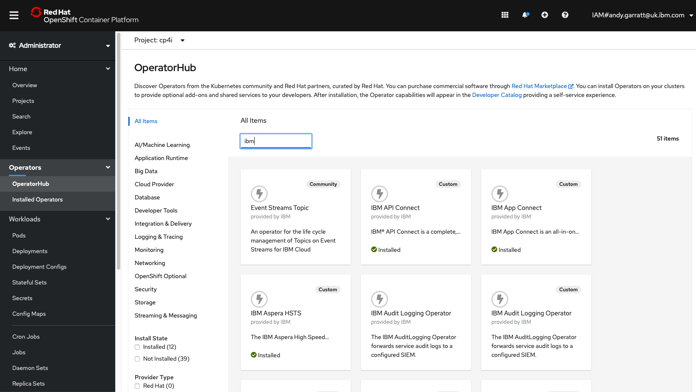
2020.2.1 (June)
ICP4I now uses Operators – so does App Connect

Slide 83
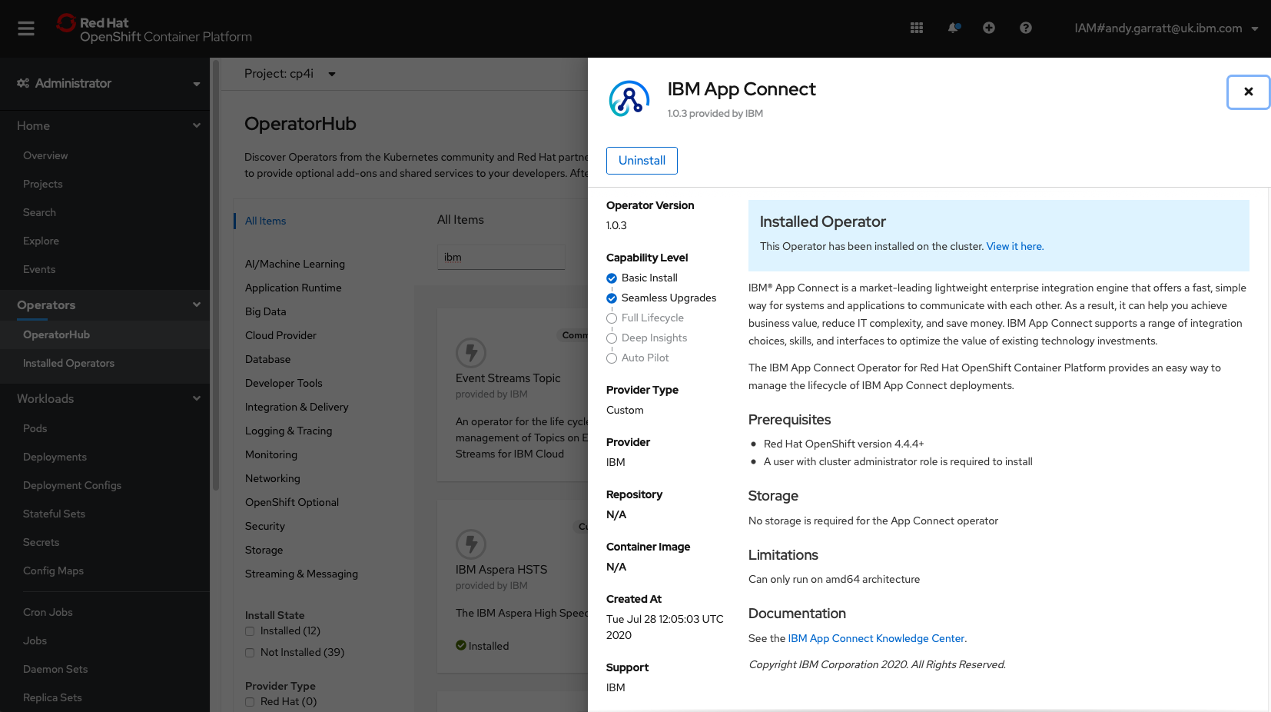
2020.2.1 (June)

Slide 84

2020.2.1 (June)

Slide 85

2020.2.1 (June)

Slide 86



Versioning and upgrading…
Integration Pod B
V4
Integration Pod B
V4
Ingress
Integration Pod B
V3
Integration Pod B
V3
Integration Pod B
V3
Integration Pod B
V3
Notes:
We want to be able to deploy in a risk-free way.
We want to be able to deploy

Slide 87
Enough pods? Reroute requests & drop old version
Integration Pod B
V4
Integration Pod B
V4
Ingress
Integration Pod B
V3
Integration Pod B
V3
Integration Pod B
V3
Integration Pod B
V3

Slide 88
And finally fully roll out new version
Integration Pod B
V4
Integration Pod B
V4
Integration Pod B
V4
Integration Pod B
V4
Ingress

Slide 89
Rollback? Consider same ‘roll forward’ pattern
Integration Pod B
V4
Integration Pod B
V4
Integration Pod B
V4
Integration Pod B
V4
Ingress
Integration Pod B
V3
Integration Pod B
V3

Slide 90
Redeploy immutable V3 containers/pods/chart
And remove ‘bad’ version
Integration Pod B
V4
Integration Pod B
V4
Integration Pod B
V4
Integration Pod B
V4
Ingress
Integration Pod B
V3
Integration Pod B
V3

Slide 91
And finally we are back where we were before
Ingress
Integration Pod B
V3
Integration Pod B
V3
Integration Pod B
V3
Integration Pod B
V3

Slide 92
Can we run both in parallel? Yes! Make another Deployment
Integration Pod B
V4
Integration Pod B
V4
Integration Pod B
V4
Integration Pod B
V4
Ingress
Integration Pod B
V3
Integration Pod B
V3
Integration Pod B
V3
Integration Pod B
V3

Slide 93
Infrastructure as code – no ‘single route to live’
ESB: ACE V11.0.0.0
ACE V11.0.0.4
ACE V11.0.0.0
ACE V11.0.0.3
MQ
“PROD”
Flow A V1
Flow B V1
Flow C V1
Flow D V1
MQ
Flow R V3
Flow S V1
MQ
Flow T V2
ESB: ACE V11.0.0.0
ACE V11.0.0.4
“UAT”
MQ
Flow A V1
Flow B V1
Flow C V1
Flow D V1
MQ
Flow R V3
ESB: ACE V11.0.0.0
ACE V11.0.0.4
ACE V11.0.0.0
“TEST”
MQ
Flow A V1
Flow B V1
Flow C V1
Flow D V1
MQ
Flow R V3
Flow S V1
ESB: ACE V11.0.0.0
ACE V11.0.0.4
ACE V11.0.0.0
ACE V11.0.0.3
“DEV”
MQ
Flow A V1
Flow B V1
Flow C V1
Flow D V1
MQ
Flow R V3
Flow S V1
MQ
Flow T V2
Notes:
Why do we have environments?
Because we have dependencies like MQ, Databases, ESB, Infrastructure etc.
If we took the “environments” away, could we be more agile?

Slide 94
No more “Environment Drift?”
ESB: ACE V11.0.0.0
ACE V11.0.0.4
ACE V11.0.0.0
ACE V11.0.0.3
MQ
“PROD”
Flow A V1
Flow B V1
Flow C V1
Flow D V1
MQ
Flow R V3
Flow S V1
MQ
Flow T V2
ESB: ACE V11.0.0.3
ACE V11.0.0.4
ESB: ACE V11.0.0.0
“UAT”
MQ
Flow A V1
Flow B V1
Flow C V1
Flow D V1
MQ
Flow R V3
ESB: ACE V11.0.0.4
ACE V11.0.0.4
ACE V11.0.0.0
ESB: ACE V11.0.0.0
“TEST”
MQ
Flow A V1
Flow B V1
Flow C V1
Flow D V1
MQ
Flow R V3
Flow S V1
ESB: ACE V11.0.0.0
ACE V11.0.0.4
ACE V11.0.0.0
ACE V11.0.0.3
ESB: ACE V11.0.0.4
“DEV”
MQ
Flow A V1
Flow B V1
Flow C V1
Flow D V1
MQ
Flow R V3
Flow S V1
MQ
Flow T V2
Notes:
Environments differ. Why? Because someone has to keep EVERYTHING up to date.
And every deployment or config tweak makes a difference.
Keeping environments in sync is hard. And different people have different needs for the environments leading to conflict.

Slide 95
Shift DevOps “Left”: Performance and HA/DR in DEV
ACE V11.0.0.4
ACE V11.0.0.4
ACE V11.0.0.4
ESB: ACE V11.0.0.0
MQ
“PROD”
MQ
Flow R V3
MQ
Flow R V3
MQ
Flow R V3
Flow A V1
Flow B V1
Flow C V1
Flow D V1
ESB: ACE V11.0.0.0
ACE V11.0.0.4
ACE V11.0.0.4
“UAT”
MQ
Flow A V1
Flow B V1
Flow C V1
Flow D V1
MQ
Flow R V3
MQ
Flow R V3
ESB: ACE V11.0.0.0
ACE V11.0.0.4
“TEST”
MQ
Flow A V1
Flow B V1
Flow C V1
Flow D V1
MQ
Flow R V3
Replicas
ESB: ACE V11.0.0.0
“DEV”
ACE V11.0.0.4
MQ
Flow A V1
Flow B V1
Flow C V1
Flow D V1
MQ
Flow R V3
Notes:
“It works in UAT but not in DEV”
“Be responsible for your own environment”
Why do I need to wait for UAT to do performance test? Why not in dev? Why can’t we test NFRs earlier?

Slide 96
Shift DevOps “Left”: Performance and HA/DR in DEV
ACE V11.0.0.4
ACE V11.0.0.4
ACE V11.0.0.4
ESB: ACE V11.0.0.0
MQ
“PROD”
MQ
Flow R V3
MQ
Flow R V3
MQ
Flow R V3
Flow A V1
Flow B V1
Flow C V1
Flow D V1
ESB: ACE V11.0.0.0
ACE V11.0.0.4
ACE V11.0.0.4
ACE V11.0.0.4
“UAT”
MQ
Flow A V1
Flow B V1
Flow C V1
Flow D V1
MQ
Flow R V3
MQ
Flow R V3
MQ
Flow R V3
ESB: ACE V11.0.0.0
ACE V11.0.0.4
ACE V11.0.0.4
ACE V11.0.0.4
“TEST”
MQ
Flow A V1
Flow B V1
Flow C V1
Flow D V1
MQ
Flow R V3
MQ
Flow R V3
MQ
Flow R V3
ESB: ACE V11.0.0.0
“DEV”
ACE V11.0.0.4
ACE V11.0.0.4
ACE V11.0.0.4
MQ
Flow A V1
Flow B V1
Flow C V1
Flow D V1
MQ
Flow R V3
MQ
Flow R V3
MQ
Flow R V3
Notes:
So why not Make DEV look more like PROD?
This would be great but look how many containers we now have!

Slide 97
Shift DevOps “Left”: Performance and HA/DR in DEV
ACE V11.0.0.4
ACE V11.0.0.4
ACE V11.0.0.4
ESB: ACE V11.0.0.0
MQ
“PROD”
MQ
Flow R V3
MQ
Flow R V3
MQ
Flow R V3
Flow A V1
Flow B V1
Flow C V1
Flow D V1
ESB: ACE V11.0.0.0
ACE V11.0.0.4
ACE V11.0.0.4
ACE V11.0.0.4
“UAT”
MQ
Flow A V1
Flow B V1
Flow C V1
Flow D V1
MQ
Flow R V3
MQ
Flow R V3
MQ
Flow R V3
ESB: ACE V11.0.0.0
ACE V11.0.0.4
ACE V11.0.0.4
ACE V11.0.0.4
“TEST”
MQ
Flow A V1
Flow B V1
Flow C V1
Flow D V1
MQ
Flow R V3
MQ
Flow R V3
MQ
Flow R V3
ESB: ACE V11.0.0.0
“DEV”
ACE V11.0.0.4
ACE V11.0.0.4
ACE V11.0.0.4
MQ
Flow A V1
Flow B V1
Flow C V1
Flow D V1
MQ
Flow R V3
MQ
Flow R V3
MQ
Flow R V3
Notes:
HOwever if DEV looks more like prod – how many environments do you need?

Slide 98
“Think Cloud” – Only spin up when you need it
ACE V11.0.0.4
ACE V11.0.0.4
ACE V11.0.0.4
ESB: ACE V11.0.0.0
MQ
“PROD”
MQ
Flow R V3
MQ
Flow R V3
MQ
Flow R V3
Flow A V1
Flow B V1
Flow C V1
Flow D V1
ESB: ACE V11.0.0.0
ACE V11.0.0.4
ACE V11.0.0.4
ACE V11.0.0.4
“UAT”
MQ
Flow A V1
Flow B V1
Flow C V1
Flow D V1
MQ
Flow R V3
MQ
Flow R V3
MQ
Flow R V3
ESB: ACE V11.0.0.0
ACE V11.0.0.4
ACE V11.0.0.4
ACE V11.0.0.4
“TEST”
MQ
Flow A V1
Flow B V1
Flow C V1
Flow D V1
MQ
Flow R V3
MQ
Flow R V3
MQ
Flow R V3
ESB: ACE V11.0.0.0
“DEV”
ACE V11.0.0.4
ACE V11.0.0.4
ACE V11.0.0.4
MQ
Flow A V1
Flow B V1
Flow C V1
Flow D V1
MQ
Flow R V3
MQ
Flow R V3
MQ
Flow R V3
Notes:
Environments cost money
Do you use them all, all the time?
Spin them up when you need them – drop them when you don’t. Use the cloud philosophy.

Slide 99
Each deployment can have a different number of replicas

Slide 100


Slide 101


“Baking vs Frying”

Slide 102
“Baking vs Frying”
Fried: ’Standard’ image used for all integrations (per version of ACE)
.BAR file added at deploy time.
Baked: Container image created with the .BAR file (and anything else ‘Baked in’): One image per integration.

Slide 103
Immutability==Consistency
Container Image Repository
ACE V11.0.0.8
ACE V11.0.0.8
Do you deploy an App Connect container and then deploy flows at runtime?
Or build a container with all of the flows ready-built into it?
Which makes DEV look more like PROD?
Which is simpler to deploy?
FlowB V1
Runtime
ACE V11.0.0.8
ACE V11.0.0.8
FlowA V1
FlowB V1
Integration / .bar Repository
FlowA V1
FlowA V2
FlowB V1
Notes:
So what kind of images do you build? ACE? Or ACE+Flows?

Slide 104


“Baking” App Connect Images is not that hard . .

Slide 105






What about deployment consistency and automation?
POST drivewayrepair/quote GET drivewayrepair/quote/{id}
POST drivewayrepair/appointment (future)
API / Calls
Tracing Data
API Connect
“Scatter gather pattern”
Or “Compare the Market/Meerkat” Insurance style:
App Connect
Quotes DB
OD Tracing
Logging Monitoring
MQ
App Connect
App Connect
App Connect
ACME Auto Accidents
Bernie’s Bashed Bumpers
Chris’s
Crumpled Cars
Or Booking flight/hotels– any kind of online competitive marketplace.

Slide 106

Pipelines allow us to automate deployments. Predictable. Repeatable.

Slide 107
2020.1.1 (March)
Pipelines allow us to automate deployments. Predictable. Repeatable.

Slide 108
2020.2.1 (June)
2020.1.1 (March) = OpenShift 4.3
2020.2.1 (June) = OpenShift 4.4+

Slide 109

Pipelines are made up of tasks – tasks can be reused.

Slide 110

A pipeline run is all of the tasks needed – can deploy the entire ‘solution’

Slide 111

Check out github for samples for this (WIP) – the ‘Car Crash’ demo is on public git too

Slide 112

Image streams can be used to store ‘baked’ container images

Slide 113

Keeps the ‘history’ and tags versions – can also use ‘latest’

Slide 114

Centralized Monitoring: Dashboards can be filtered by Applications

Slide 115

Centralized logging can be searched and filtered as desired

Slide 116
Key Takeaways
Running App Connect on CP4i is straightforward – it’s handy to know what it looks like underneath though.
CP4i makes running App Connect in containers a LOT easier.
Bring your existing integrations along!
Explore what CP4i and OpenShift can offer your App Connect flows.
Built-in Monitoring, Logging and Tracing
Leverage ‘Built in’ HA, Scaling, Security
Review your environment strategy “What is an environment (for)?”
“Environments” in CP4i are a lot more flexible!
Lots of flexibility with multi-versions and fixpacks
Know how the deployment model works.
Leverage CI/CD and GitOps – version your deploys declaratively.
Be aware of ‘Baked’ and ‘Fried’ approaches
Plan to upgrade to Operators

Slide 117
Thank you
Andy Garratt
Offering Manager, IBM Cloud Pak for Integration
andyg@uk.ibm.com
https://www.ibm.com/cloud/cloud-pak-for-integration
© Copyright IBM Corporation 2020. All rights reserved. The information contained in these materials is provided for informational purposes only, and is provided AS IS without warranty of any kind, express or implied. Any statement of direction represents IBM’s current intent, is subject to change or withdrawal, and represent only goals and objectives. IBM, the IBM logo, and ibm.com are trademarks of IBM Corp., registered in many jurisdictions worldwide. Other product and service names might be trademarks of IBM or other companies. A current list of IBM trademarks is available at Copyright and trademark information.

Slide 118
IBM sign-off

